Slide 1


Research Study Design III
DEPH 312 Principles of Scientific Evidence
Talal Alshihayb ^{BDS, DScD}
Diplomate, American Board of Dental Public Health
Assistant Professor
Department of Preventive Dental Science, College of Dentistry, King Saud bin Abdulaziz University for Health Sciences
Department of Health Policy and Health Services Research, Henry M. Goldman School of Dental Medicine, Boston University
December 11, 2023
shihaybt@ksau-hs.edu.sa

Slide 2
Recap
Science of epidemiology
Study tasks
Descriptive
Predictive
Causal
Descriptive epidemiology
Measures of disease occurrence
Measures of association

Slide 3
Measures of disease association
Compare measures of disease occurrence between groups
Difference
Risk difference (incidence proportion difference)
Incidence rate difference
Incidence time difference
Null value 0
0 means no difference
Ratio
Risk ratio
Incidence rate ratio
Incidence time ratio
Hazard ratio
Incidence odds ratio
Prevalence ratio
Prevalence odds ratio
Null value 1
1 means no difference

Slide 4

LECTURE LEARNING OUTCOMES OF EACH OF THE DIDACTIC SESSIONS
REFERENCE:
Chapter 5 in Rothman KJ. Epidemiology: an introduction. Oxford university press; 2012 May 4
Sections 1.4, 1.6, and 1.7 of Chapter 1 in Oral Epidemiology A Textbook on Oral Health Conditions, Research Topics and Methods
P. 123-127 Chapter 12 in Dentistry, Dental Practice, and the Community 7th edition
LECTURE LEARNING OUTCOMES:
Differentiate between observational and interventional studies.
Recognize types, advantages and disadvantage of each study design.

Slide 5
The different research/study tasks
Measures of disease occurrence
Descriptive
What is the prevalence of lung cancer among Saudis? males and females? By region?
What is the incidence of lung cancer among Saudis? males and females? By region?
Communicating observed world
Identify how large the public health problem is
Helps in setting priorities
Predictive (factual prediction)
Who will get lung cancer in Saudi Arabia in the next 5 years?
Diagnostics (If you have these characteristics, how likely are you to have a disease, which cannot be directly observed?)
Prognostics (If you have these characteristics, how likely are you to develop a disease, which cannot be directly observed?)
Identify who is at risk of the outcome (e.g., lung cancer) or how their disease progress over time
Future disease burden (Helps in setting priorities)
Does not help you on knowing what to intervene on to prevent the outcome
Causal (counterfactual prediction)
Would smokers get lung cancer had they not smoked?
Compare what actually happened to what would have happened, counter to fact, had the exposure been different
Helps you on knowing what to intervene on to prevent the outcome
Model performance
Measures of association
Hernán MA, Hsu J, Healy B. A second chance to get causal inference right: a classification of data science tasks. Chance. 2019 Jan 2;32(1):42-9.

Slide 6
The goal is to correctly estimate
For descriptive task
Measure of disease occurrence:
Prevalence
Incidence
For a predictive task
Mean squared error
Root mean squared error
Sensitivity
Specificity
Predictive value (positive or negative)
Area under the curve (ROC)
For a causal task
Measures of disease association:
Difference scale (risk difference, rate difference, time difference, etc.)
Ratio scale (risk ratio, rate ratio, odds ratio, time ratio, etc.)

Slide 7
But how can we correctly estimate these in studies?

Slide 8
First, we need a research question, right?
We need to identify the study task (descriptive, predictive, causal)

Slide 9
We then need a research study design to correctly estimate the needed quantity based on the study task

Slide 10
Why need a research design?
Our intuition might be wrong
Can get wrong answers
To make sure we get a correct answer
The effect: An Introduction to Research Design and Causality by Nick Huntington-Klein https://theeffectbook.net/

Slide 11
Aspects of a study design
Who is included in your study?
How do you recruit them?
What are the variables of interest?
Only outcomes and covariates
Or exposure, outcome, and covariates
If interested in an exposure, is it the researcher who determines the level of the exposure?
How do you measure these variables?
When do you measure these variables?
More

Slide 12
Study designs
Descriptive task
Causal task
Case reports
Cohort
(longitudinal)
Observational
Interventional/experimental
Case series
Cross-sectional
Case-crossover
Cross-sectional
Randomized clinical trials
Ecological
Cohort
(longitudinal)
Case-control

Slide 13
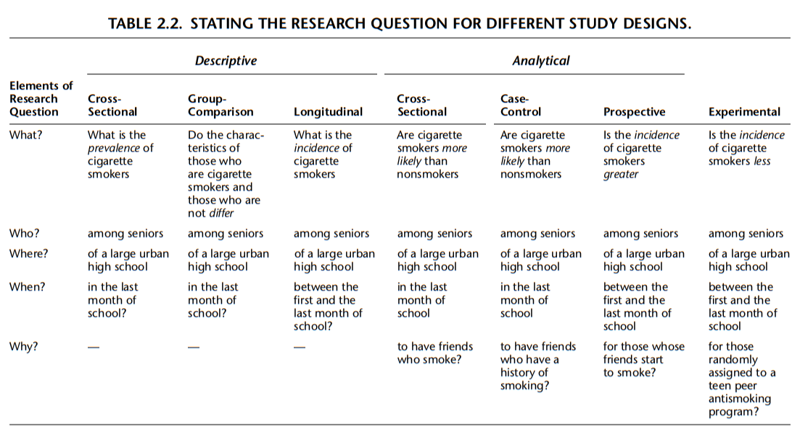
/Causal
Aday LA, Cornelius LJ. Designing and conducting health surveys: a comprehensive guide. John Wiley & Sons; 2006 Apr 14.

Slide 14
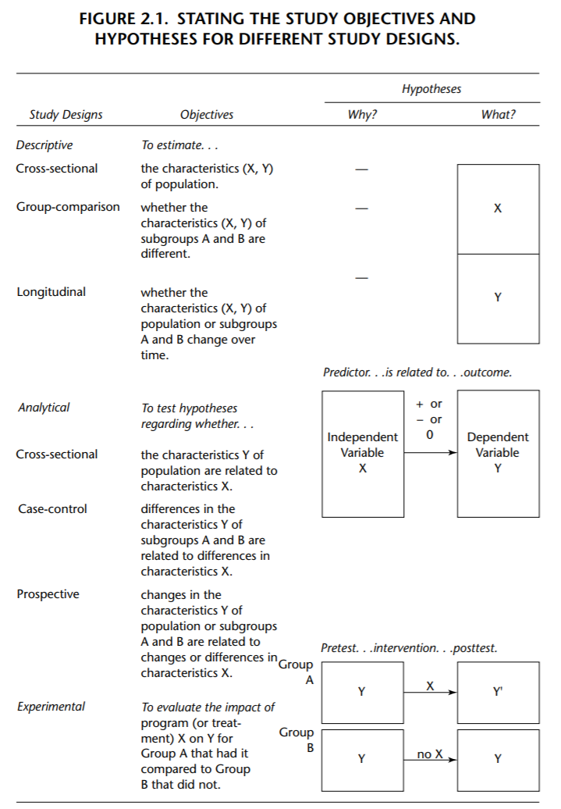
Aday LA, Cornelius LJ. Designing and conducting health surveys: a comprehensive guide. John Wiley & Sons; 2006 Apr 14.

Slide 15
We will cover the descriptive and causal study designs in this course

Slide 16
Study designs
Descriptive task
Causal task
Case reports
Cohort
(longitudinal)
Observational
Interventional/experimental
Case series
Cross-sectional
Case-crossover
Cross-sectional
Randomized clinical trials
Ecological
Cohort
(longitudinal)
Case-control

Slide 17

Case reports
Only cases
Rare diseases
New investigation of outbreaks/diseases
Only include cases (those free of disease are not included)
Dependent variable
Outcome
Can you guess the measure of disease occurrence we can get here in this study design?

Slide 18
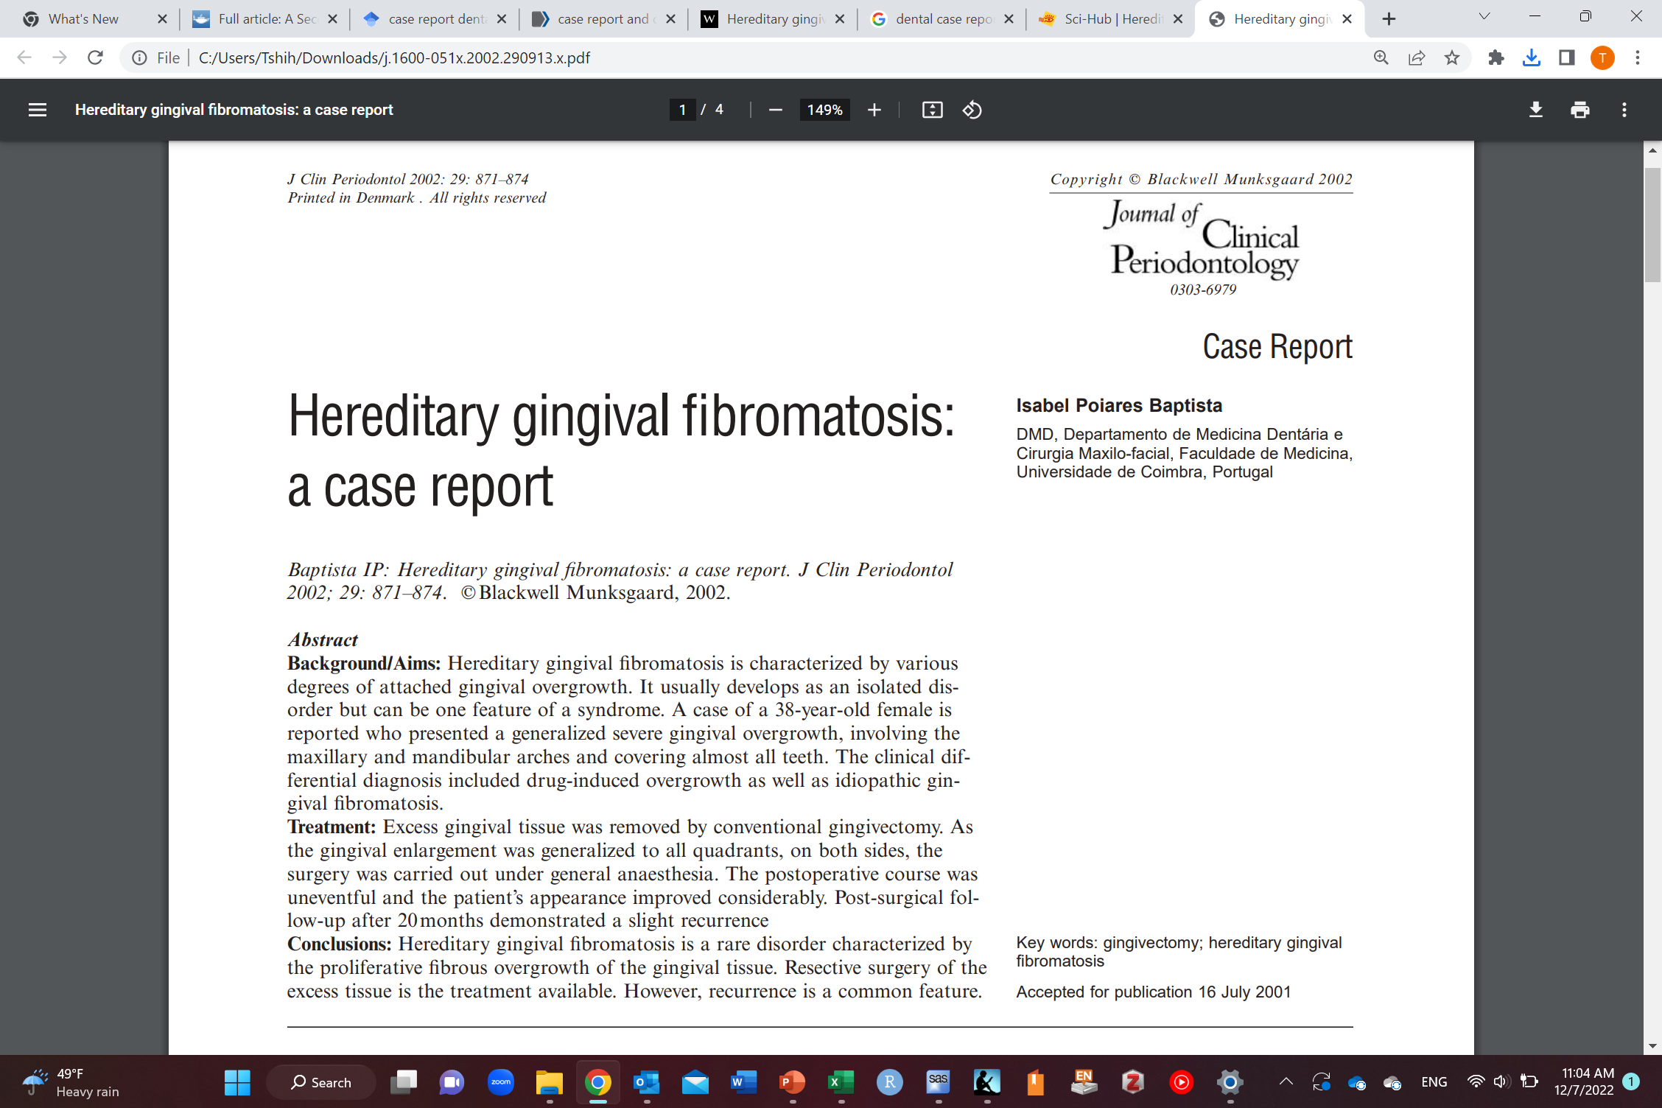
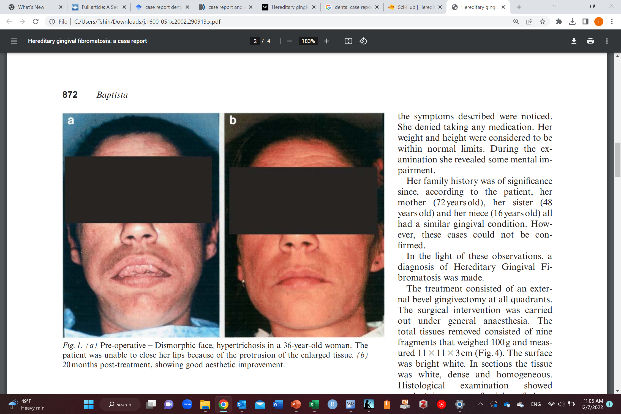
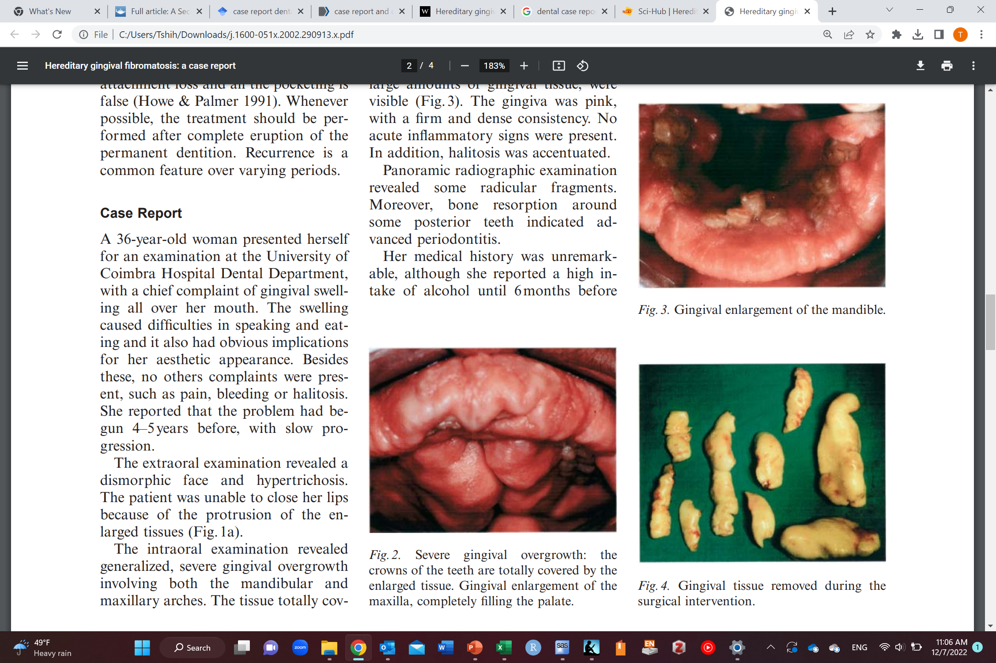
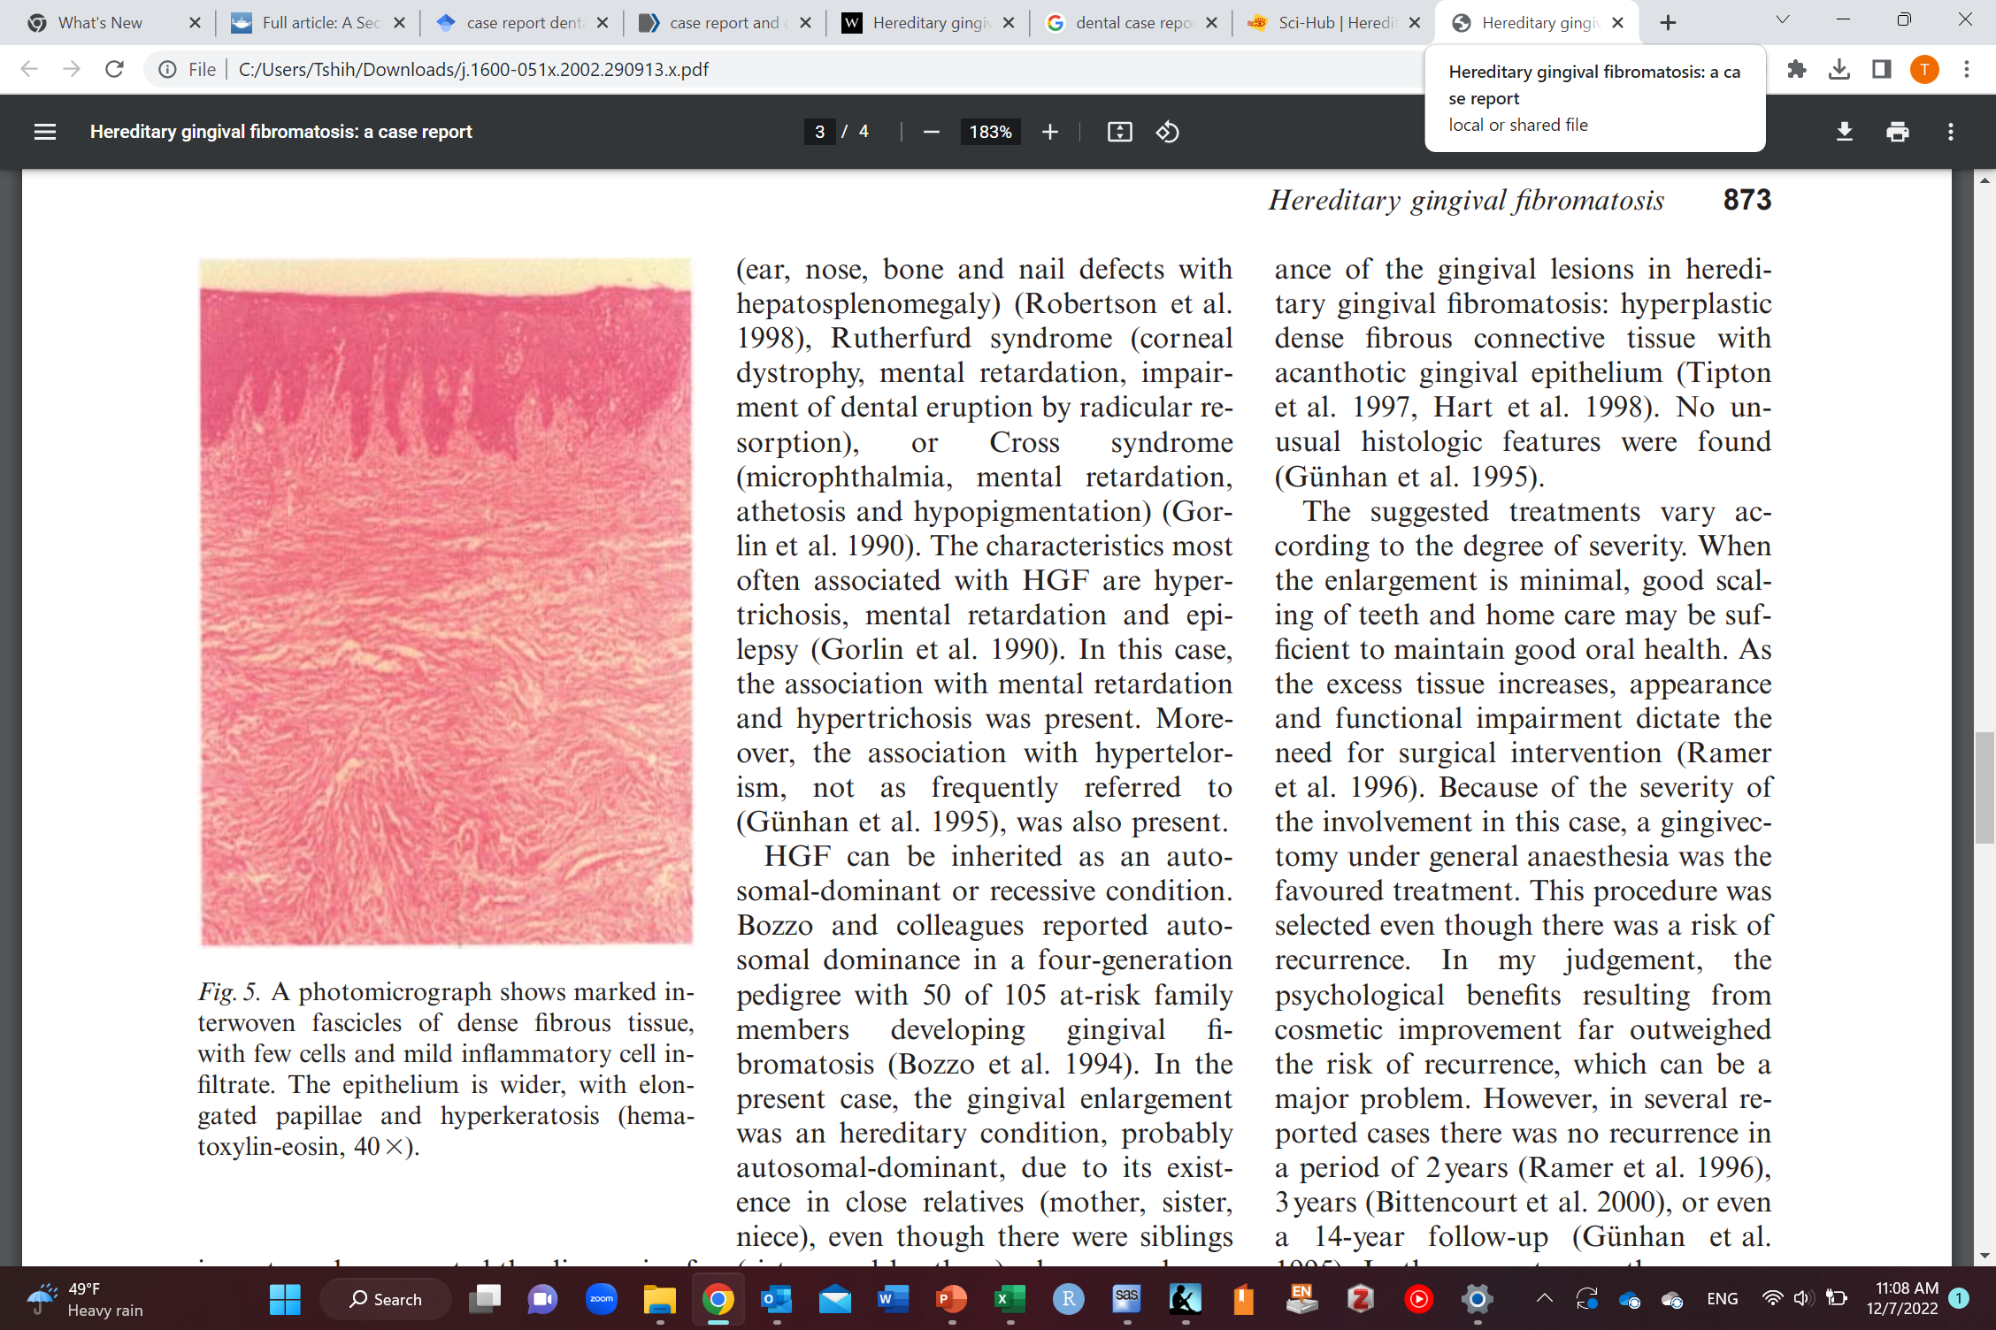
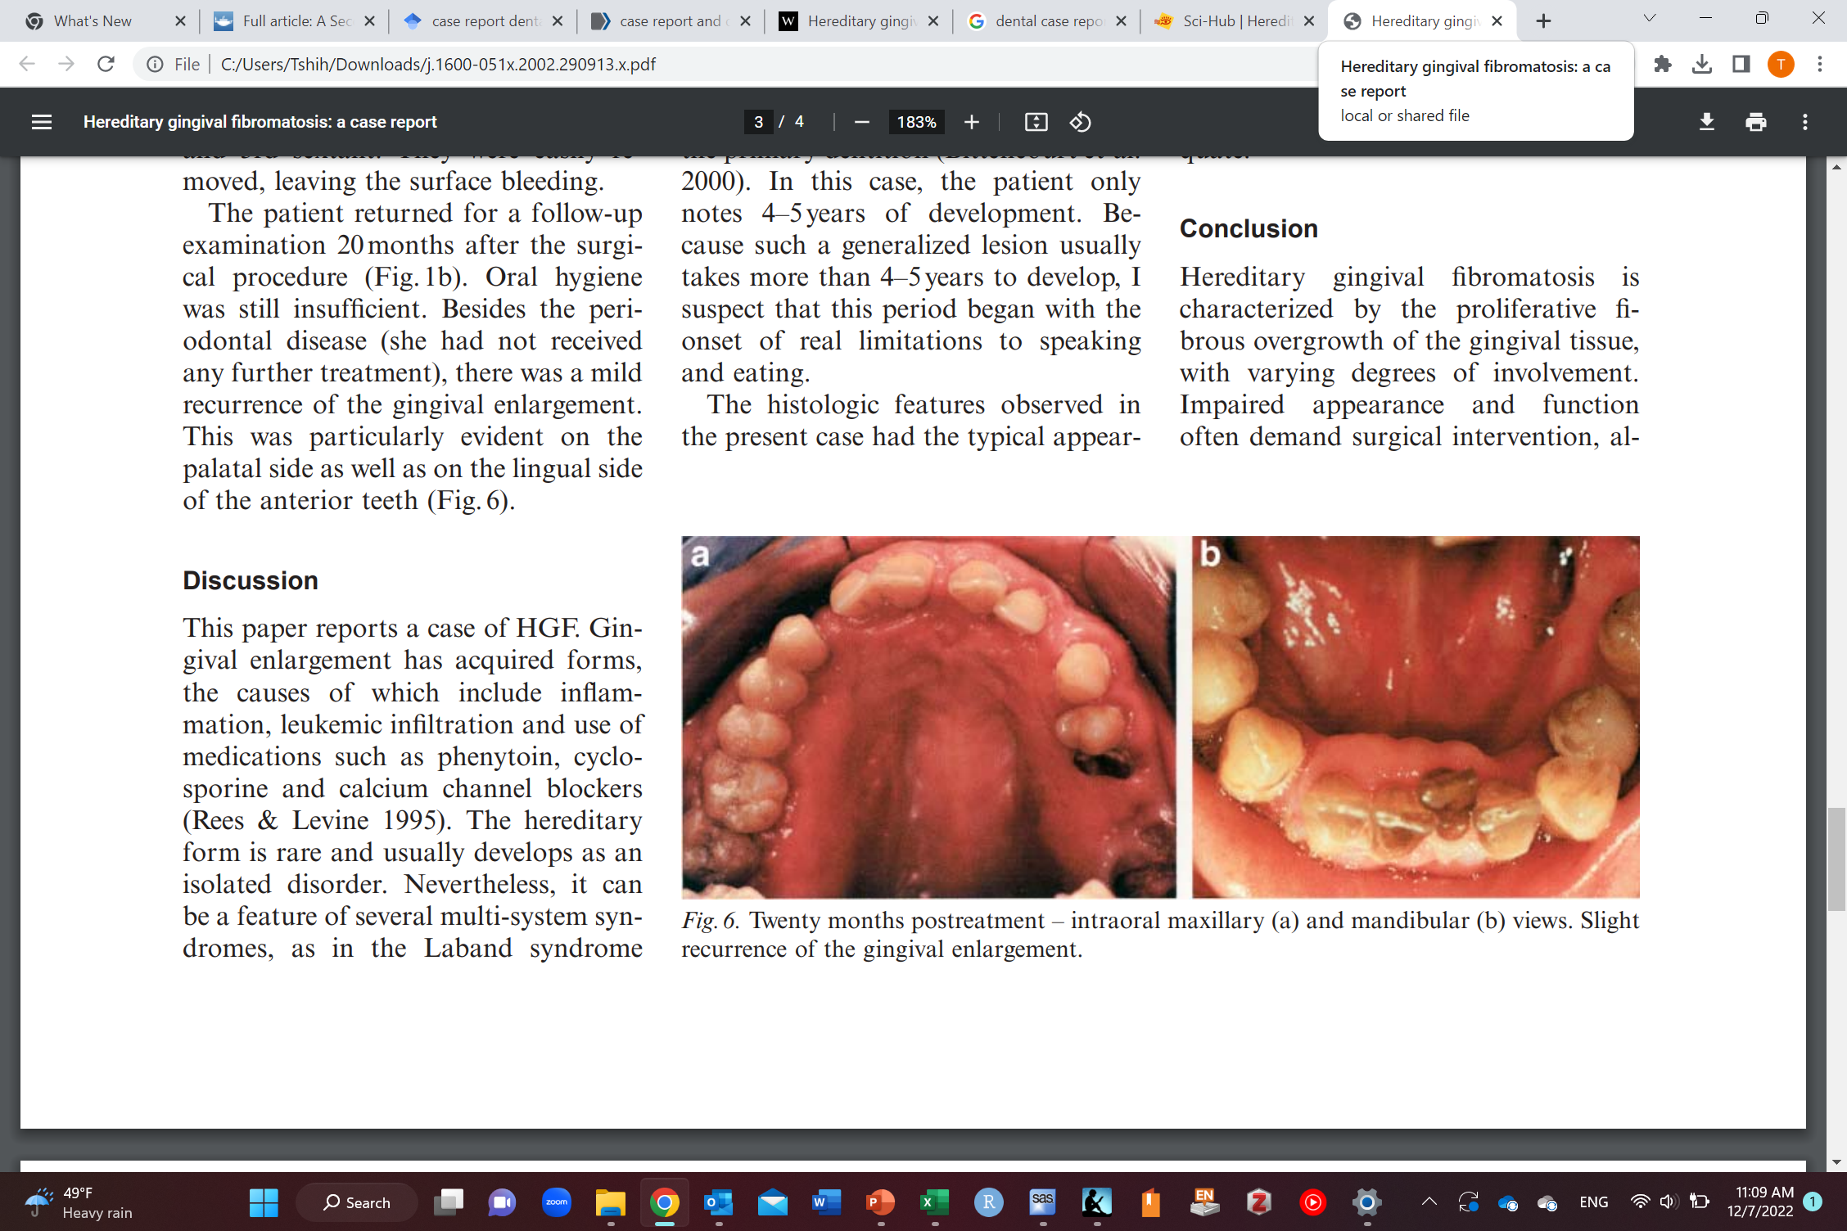
Example of a case report

Slide 19
Case series
Multiple cases
Rare diseases
New investigation of outbreaks/diseases
Only include cases (those free of disease are not included)
No cut-off point to distinguish between case reports and case series
At what number of cases does a case report become a case series
More cases the better (that’s it)
Dependent variable
Outcome
Can you guess the measure of disease occurrence we can get here in this study design?

Slide 20
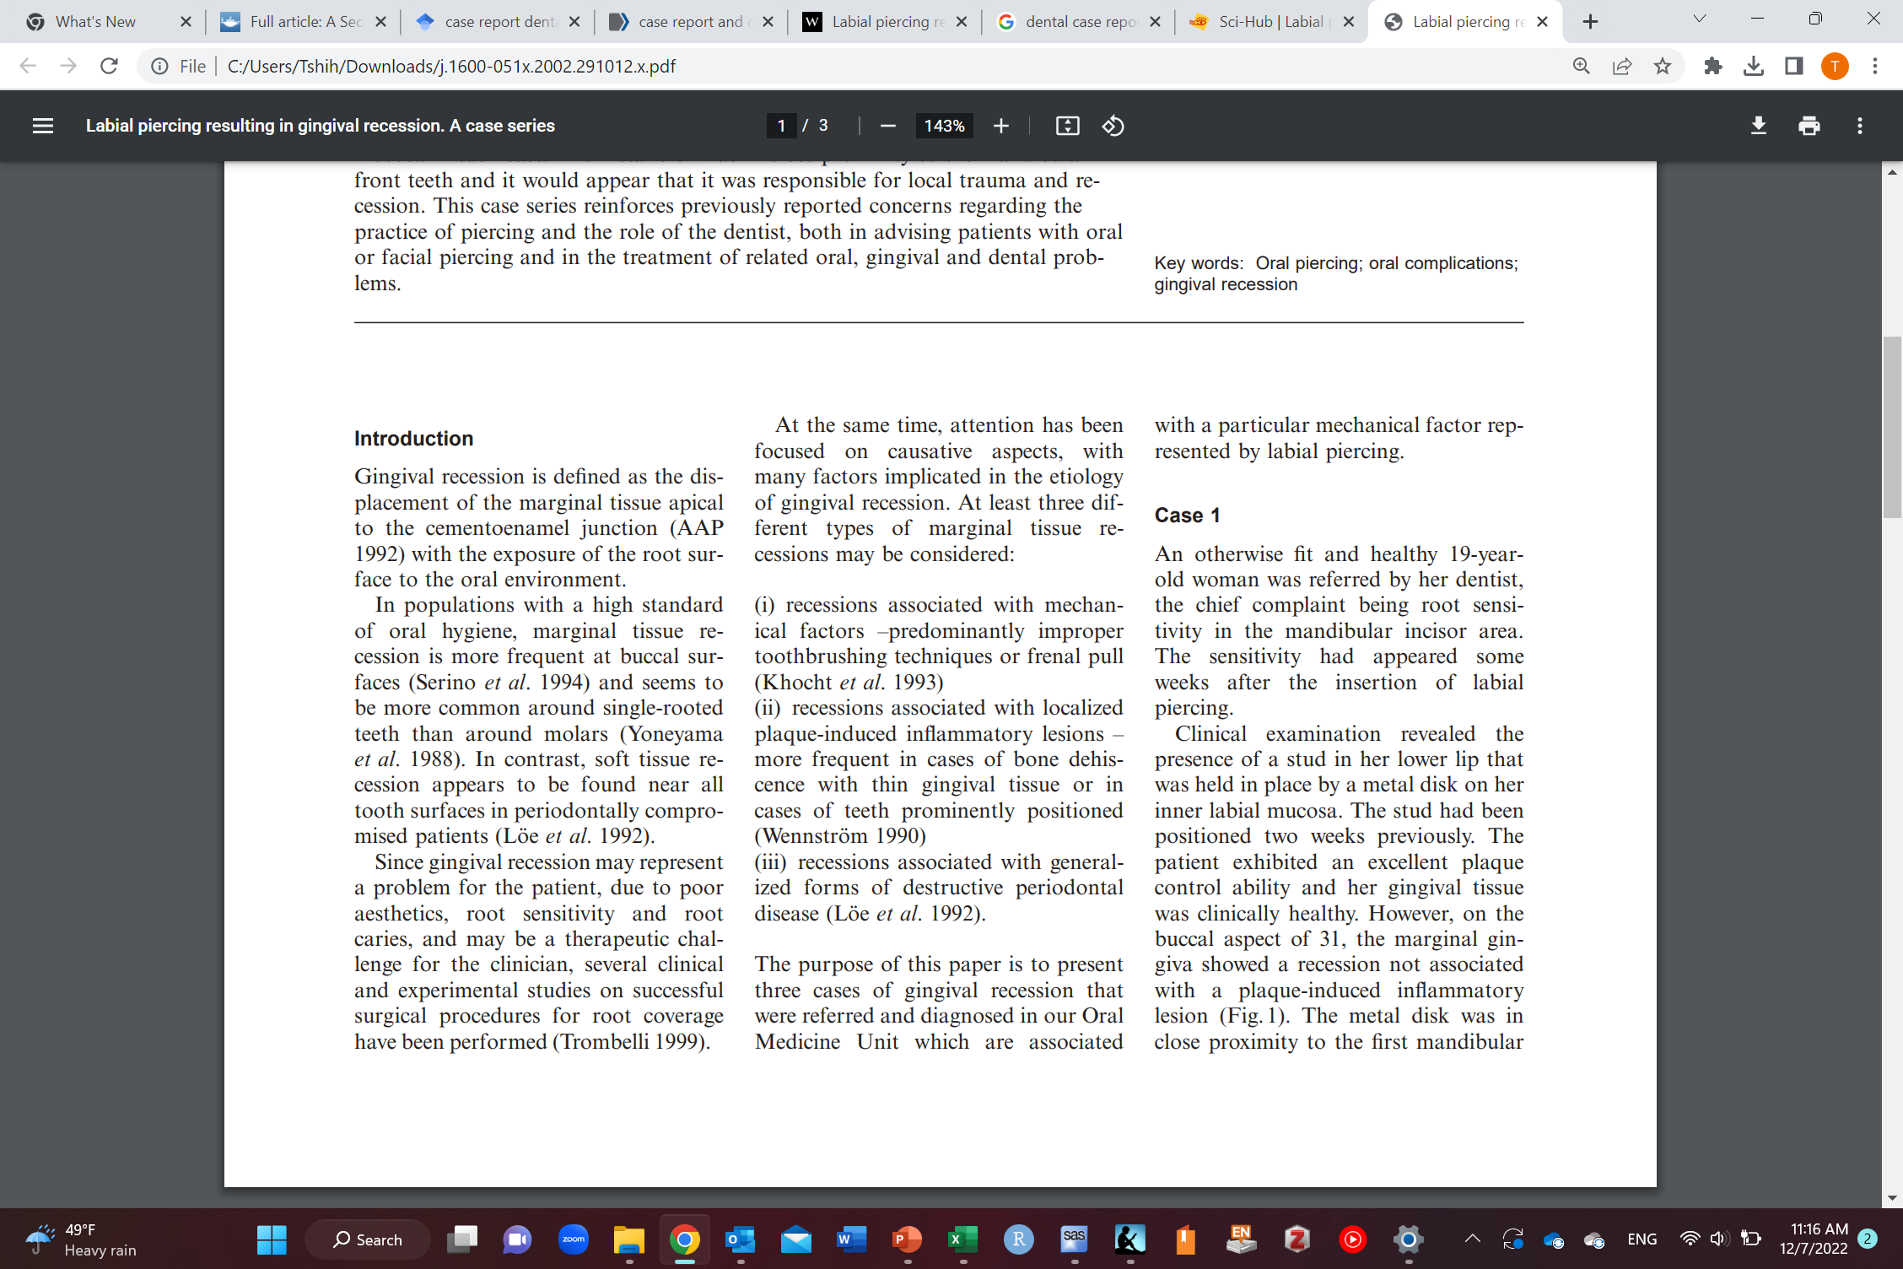
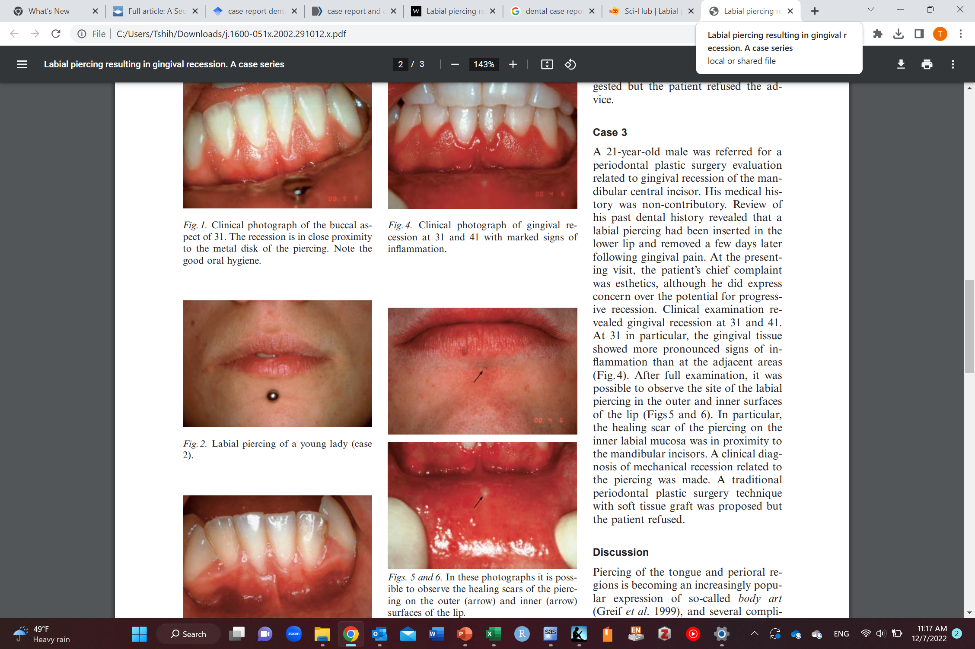
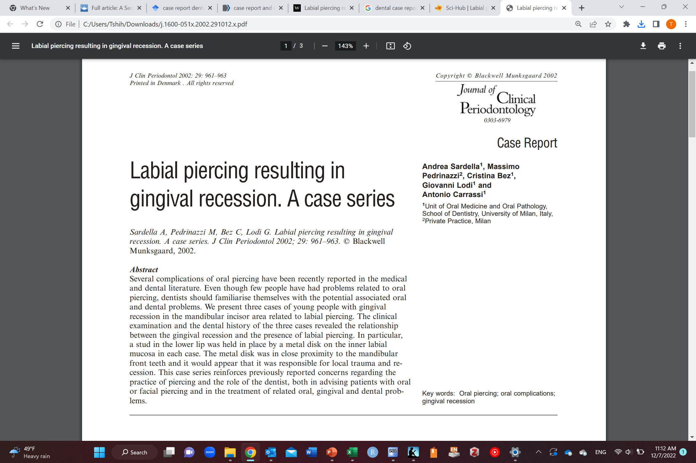
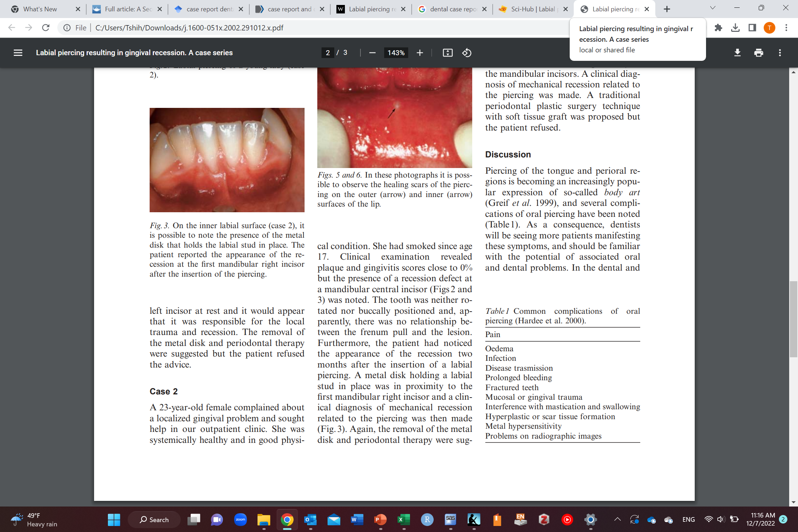
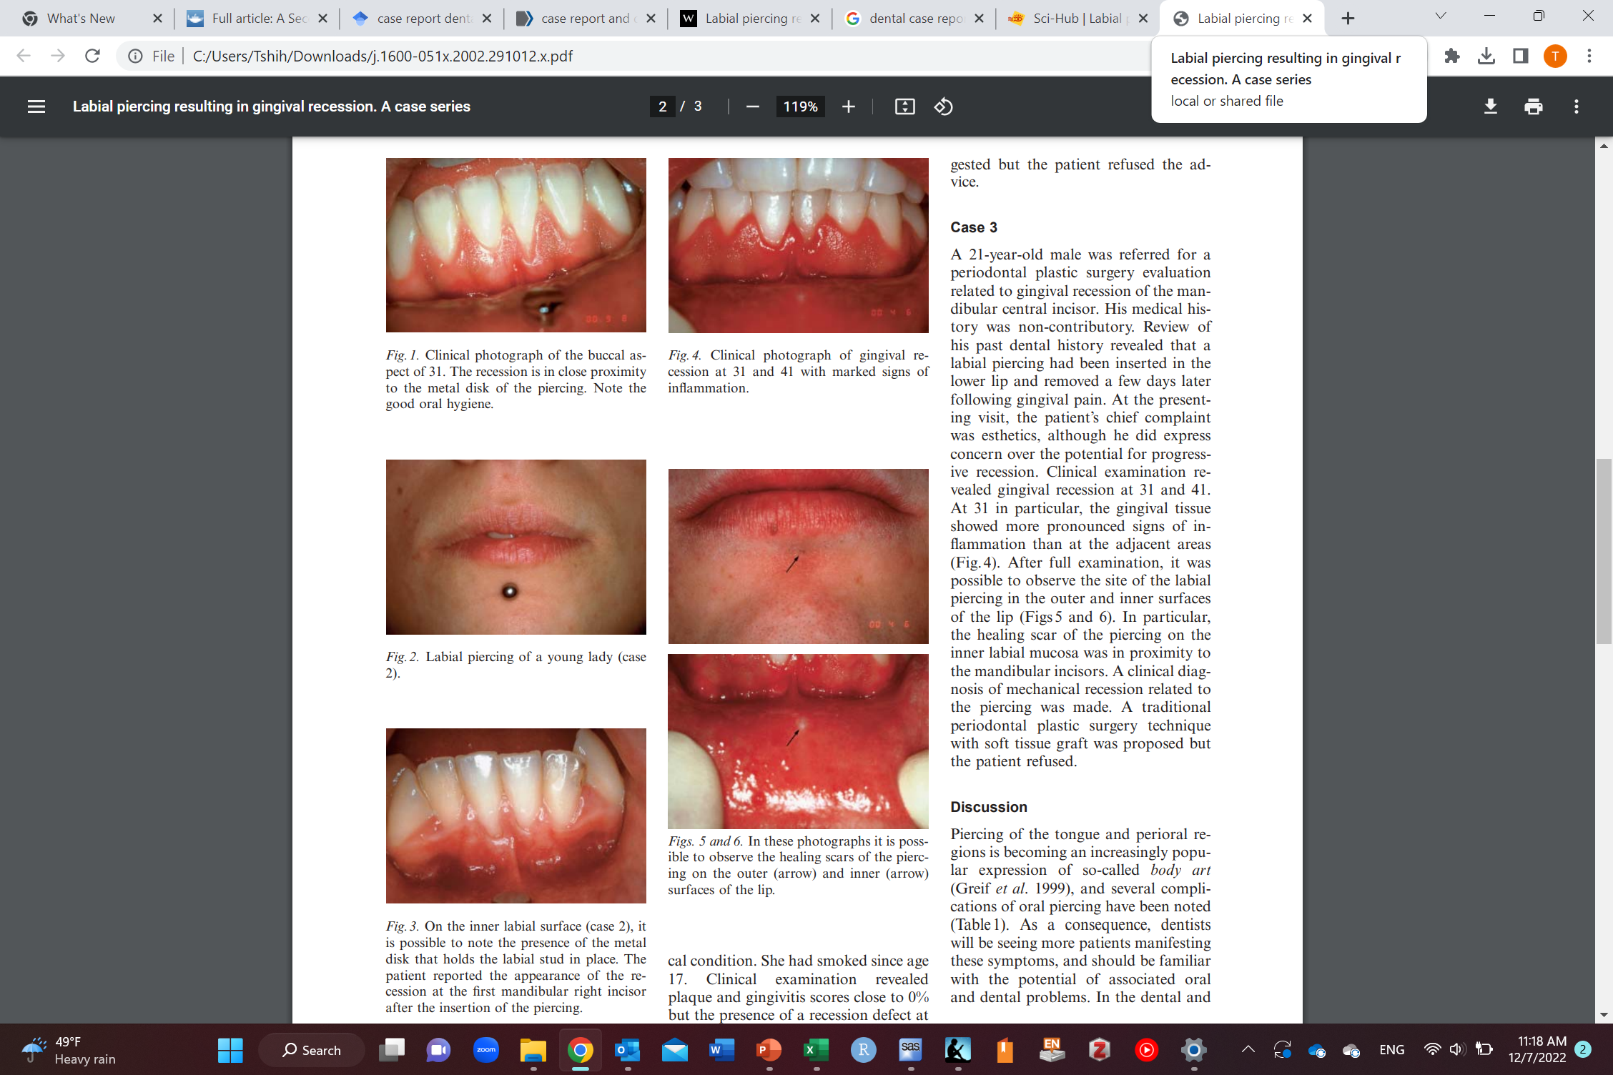
Example of a case series

Slide 21


Descriptive cross-sectional study
I want to know the prevalence of lung cancer among the Saudi population in the year 2022
I need a list of all Saudis (census)
Invite all Saudis to the study (not feasible; so take a random sample from the list)
Measure the disease/outcome (lung cancer in this case)
Calculate prevalence (or prevalence odds in case the total population is not known)
Dependent variable
Outcome

Slide 22


Descriptive cross-sectional study
I want to know the prevalence of lung cancer among male and female Saudi population in the year 2022
I need a list of all Saudis (census)
Invite all Saudis to the study (not feasible; so take a random sample from the list)
Measure the disease/outcome (lung cancer in this case)
Calculate prevalence for males and females separately
 | With lung cancer | Without lung cancer | Total
Males | A | B | A+B
Females | C | D | C+D
Total | A+C | B+D | A+B+C+D
Prevalence of lung cancer among males=$\frac{A}{A+B}$
Dependent variable
Or Outcome
Prevalence of lung cancer among females=$\frac{C}{C+D}$
Covariate

Slide 23
Descriptive cross-sectional study
I want to know the prevalence of lung cancer among male and female Saudi population in the year 2022
I need a list of all Saudis (census)
Invite all Saudis to the study (not feasible; so take a random sample from the list)
Measure the disease/outcome (lung cancer in this case)
Calculate prevalence odds for males and females separately
 | With lung cancer | Without lung cancer | Total
Males | A | B | A+B
Females | C | D | C+D
Total | A+C | B+D | A+B+C+D
Prevalence odds of lung cancer among males=$\frac{A}{1−A}=\frac{A}{B}$
Dependent variable
Or Outcome
Prevalence odds of lung cancer among females=$\frac{C}{1−C}=\frac{C}{D}$
Approximates prevalence if prevalence < 0.1
Covariate

Slide 24
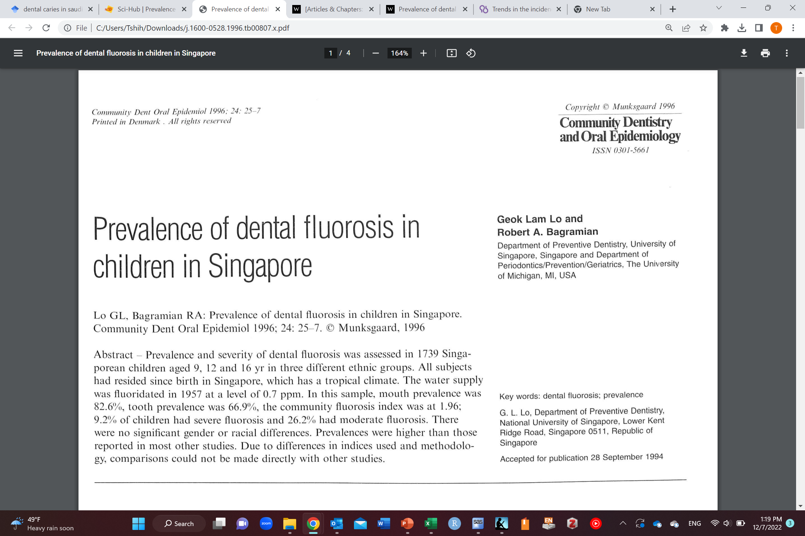
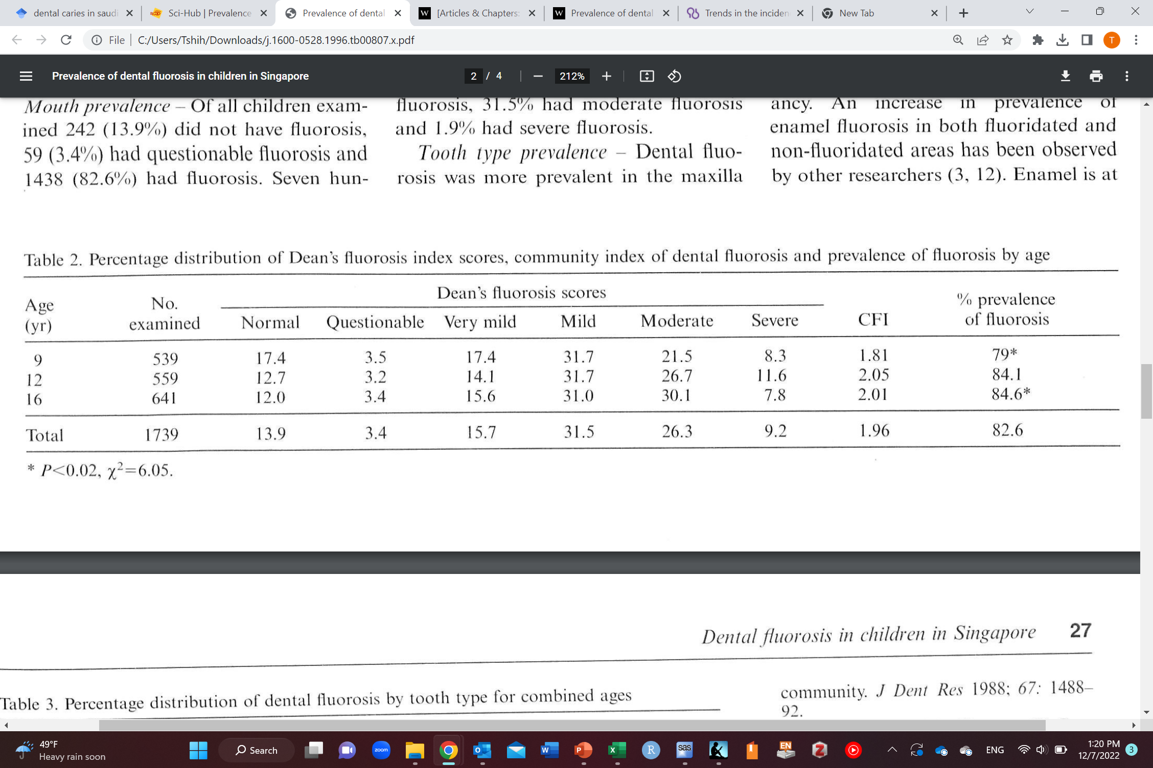
Example of a descriptive cross-sectional
Among age groups
Among everyone

Slide 25
Descriptive cohort study
I want to know the incidence of lung cancer among the Saudi population after following them for 1 year in 2022
I need a list of all Saudis (census)
Invite all Saudis to the study (not feasible; so take a random sample from the list)
Measure the disease/outcome (lung cancer in this case) at baseline (time 0)
Exclude those who already have disease/outcome (lung cancer) at baseline
Follow people at risk for developing disease (lung cancer) for 1 year
Calculate incidence proportion/risk (or incidence rate or incidence odds) of developing lung cancer after 1 year
Only those without lung cancer at baseline (at risk for developing lung cancer)
Dependent variable
Or Outcome
Time 0
Baseline
1 year

Slide 26
Descriptive cohort study
I want to know the incidence of lung cancer among male and female Saudi population after following them for 1 year in 2022
I need a list of all Saudis (census)
Invite all Saudis to the study (not feasible; so take a random sample from the list)
Measure the disease/outcome (lung cancer in this case) at baseline (time 0)
Exclude those who already have disease/outcome (lung cancer) at baseline
Follow people at risk for developing disease (lung cancer) for 1 year
Calculate incidence proportion/risk of developing lung cancer after 1 year for males and females separately
 | Develop lung cancer | Doesn’t develop lung cancer | Total
Males | A | B | A+B
Females | C | D | C+D
Total | A+C | B+D | A+B+C+D
Incidence proportion of lung cancer among males=$\frac{A}{A+B}$
Dependent variable
Or Outcome
Incidence proportion of lung cancer among females=$\frac{C}{C+D}$
Covariate

Slide 27
Descriptive cohort study
I want to know the incidence of lung cancer among male and female Saudi population after following them for 1 year in 2022
I need a list of all Saudis (census)
Invite all Saudis to the study (not feasible; so take a random sample from the list)
Measure the disease/outcome (lung cancer in this case) at baseline (time 0)
Exclude those who already have disease/outcome (lung cancer) at baseline
Follow people at risk for developing disease (lung cancer) for 1 year
Calculate incidence odds of developing lung cancer after 1 year for males and females separately (if the total is not known)
 | Develop lung cancer | Doesn’t develop lung cancer | Total
Males | A | B | A+B
Females | C | D | C+D
Total | A+C | B+D | A+B+C+D
Incidence odds of lung cancer among males=$\frac{A}{B}$
Dependent variable
Or Outcome
Incidence odds of lung cancer among females=$\frac{C}{D}$
Covariate

Slide 28
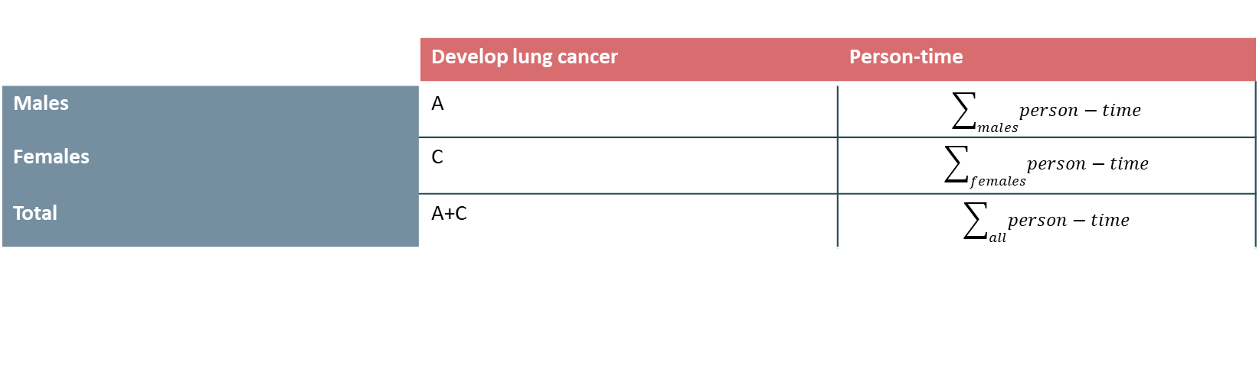
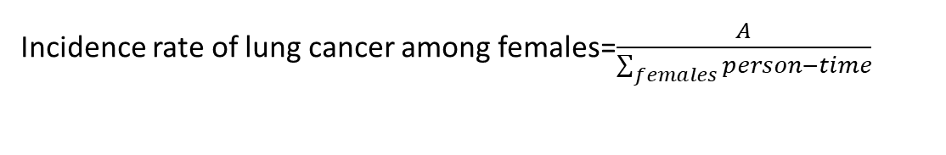
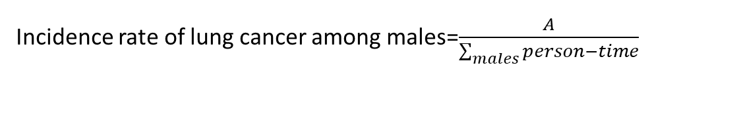
Descriptive cohort study
I want to know the incidence of lung cancer among male and female Saudi population after following them for 1 year in 2022
I need a list of all Saudis (census)
Invite all Saudis to the study (not feasible; so take a random sample from the list)
Measure the disease/outcome (lung cancer in this case) at baseline (time 0)
Exclude those who already have disease/outcome (lung cancer) at baseline
Follow people at risk for developing disease (lung cancer) for 1 year
Calculate incidence rate of developing lung cancer after 1 year for males and females separately (If follow-up was incomplete or there were competing events)
 | Develop lung cancer | Person-time
Males | A | $$\sum_{males}{person−time}$$
Females | C | $$\sum_{females}{person−time}$$
Total | A+C | $$\sum_{all}{person−time}$$
Dependent variable
Or Outcome
Incidence rate of lung cancer among males=$\frac{A}{\sum_{males}{person−time}}$
Incidence rate of lung cancer among females=$\frac{A}{\sum_{females}{person−time}}$
Covariate

Slide 29
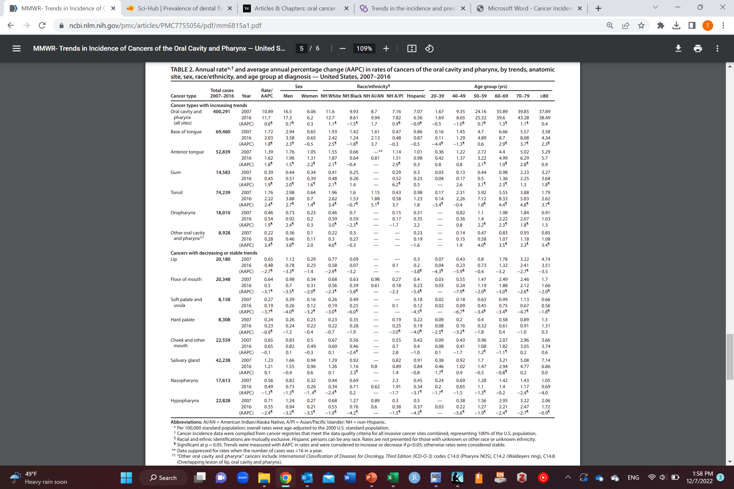
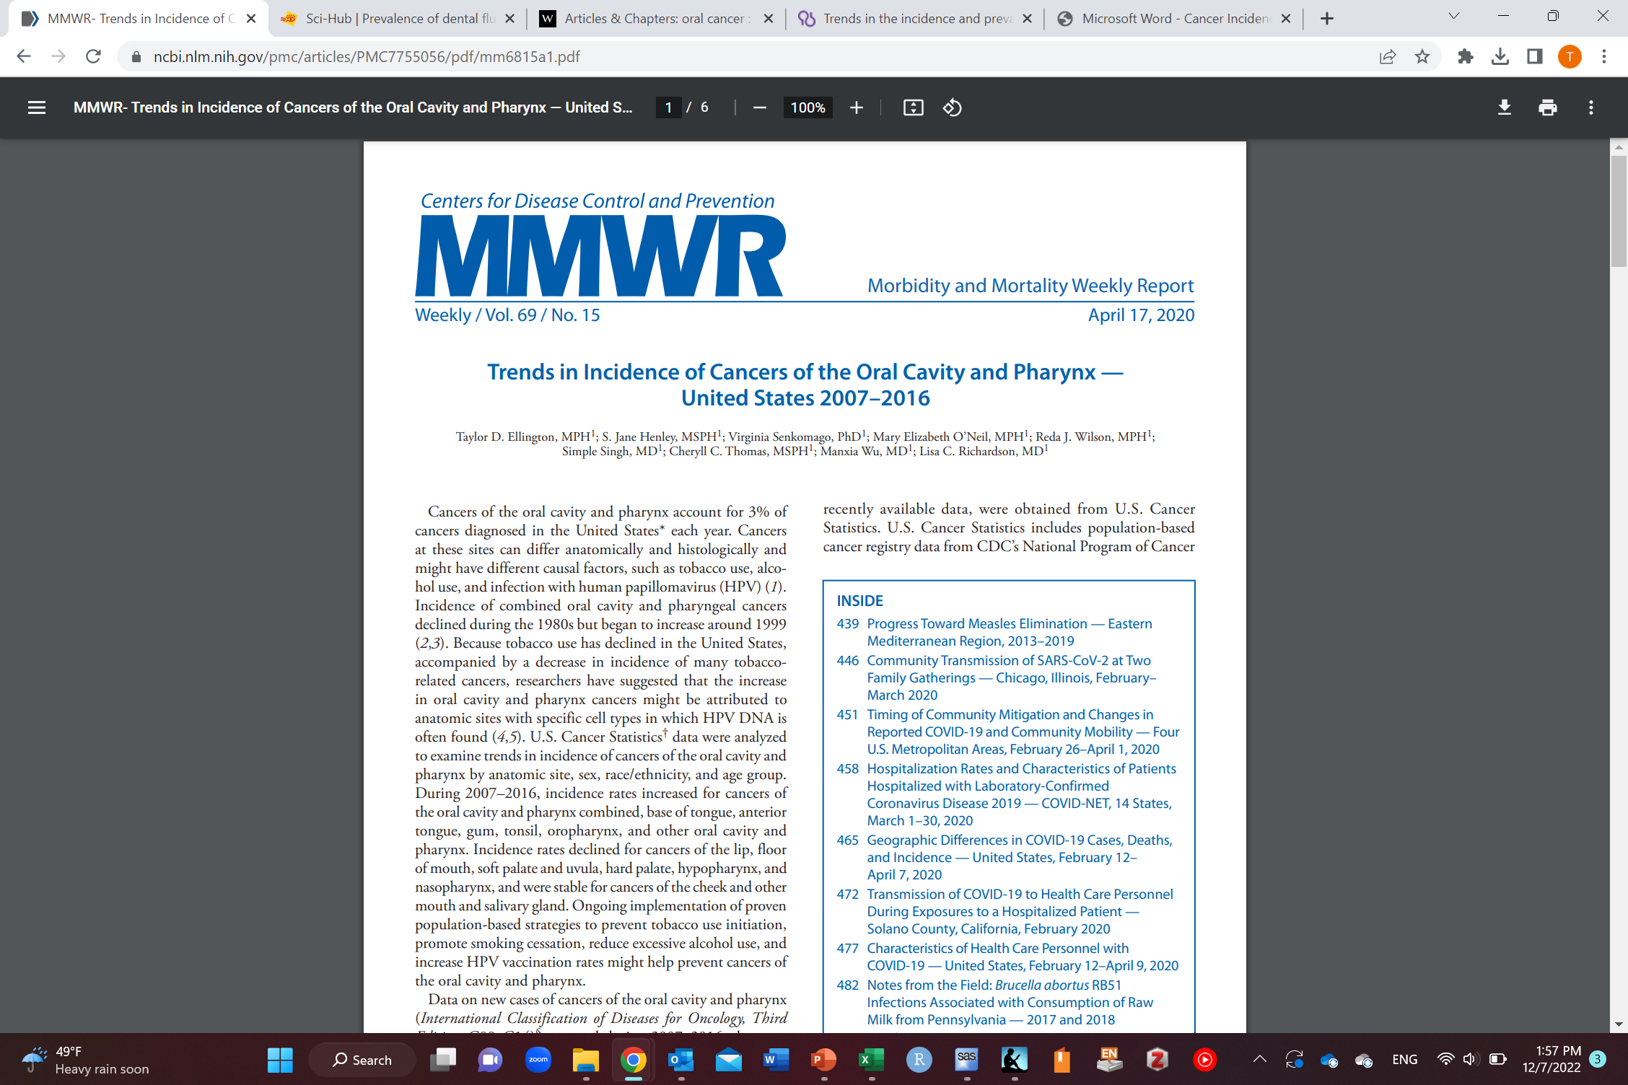
Example of a descriptive cohort

Slide 30
Study designs
Descriptive task
Causal task
Case reports
Cohort
(longitudinal)
Observational
Interventional/experimental
Case series
Cross-sectional
Case-crossover
Cross-sectional
Randomized clinical trials
Ecological
Cohort
(longitudinal)
Case-control

Slide 31
Observational vs interventional/experimental study designs
Observational
Cross-sectional
Case-control
Cohort
Ecological studies
Case-crossover
Quasi-experimental
Difference in difference
Interrupted time series
Regression discontinuity design
Instrumental variable
Interventional/experimental
Randomized clinical trial
 |  | Randomization
 |  | Yes | No
Exposure manipulation (experimental) | Yes | RCT | Quasi-experimental designs
Exposure manipulation | No |  | Observational

Slide 32
Observational vs interventional/experimental study designs
Observational
Cross-sectional
Case-control
Cohort
Ecological studies
Case-crossover
Difference in difference
Interrupted time series
Regression discontinuity design
Instrumental variable
Interventional/experimental
Randomized clinical trial
 |  | Randomization
 |  | Yes | No
Exposure manipulation (experimental) | Yes | RCT | Difference in difference, interrupted time series, regression discontinuity design, and instrumental variables
Exposure manipulation | No |  | Cross-sectional, case-control, cohort, ecological, and case-crossover

Slide 33



Randomized clinical trials (RCTs)
Independent variable
Exposure
Only
Dependent variable
Outcome
Time 0
Baseline
Time

Slide 34
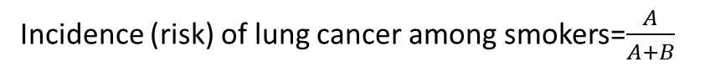
Randomized clinical trials (RCTs)
Time 0
Baseline
Time
 | With lung cancer | Without lung cancer | Total
Smokers | A | B | A+B
Non-smokers | C | D | C+D
Total | A+C | B+D | A+B+C+D
Incidence (risk) of lung cancer among smokers=$\frac{A}{A+B}$
Incidence (risk) of lung cancer among non-smokers=$\frac{C}{C+D}$
Incidence (risk) difference= $\text{incidence}\text{ (}\text{risk}\text{) }\text{of} \text{lung} \text{cancer} \text{among} \text{smokers} −\text{incidence}\text{ (}\text{risk}\text{) }\text{of} \text{lung} \text{cancer} \text{among} \text{non}\text{−}\text{smokers}$= $\frac{A}{A+B}$ - $\frac{C}{C+D}$
Incidence (risk) ratio=$\frac{\text{incidence} \text{(}\text{risk}\text{) }\text{of} \text{lung} \text{cancer} \text{among} \text{smokers}}{\text{incidence}\text{ (}\text{risk}\text{) }\text{of} \text{lung} \text{cancer} \text{among} \text{non}\text{−}\text{smokers}}$= $\frac{\frac{A}{A+B}}{\frac{C}{C+D}}$

Slide 35
Randomized clinical trials (RCTs)
Random assignment of individuals to treatment or control
Treatment assignment
Causes of outcome
Exposure
Outcome

Slide 36
Randomized clinical trials (RCTs) vs observational studies
Observational studies
Treatment assignment is not random (choice/circumstance) which also increase risk of outcome
Exception: quasi-experimental studies
Causes of exposure and outcome
Exposure
Outcome

Slide 37
Randomized clinical trials (RCTs)
Advantages
Guarantees no confounding (no mixing of effects; we will cover this later)
Temporality guaranteed (exposure comes before the outcome)
Disadvantages
Unethical
Harmful interventions (e.g., smoking)
Very expensive
Prone to selection bias (we will cove this later)
Loss to follow-up
Prone to measurement error (we will cover this later)
Limited generalizability of results (may not apply to the population)
Because trial participants are different than the general population (healthier, more compliant, etc.)

Slide 38
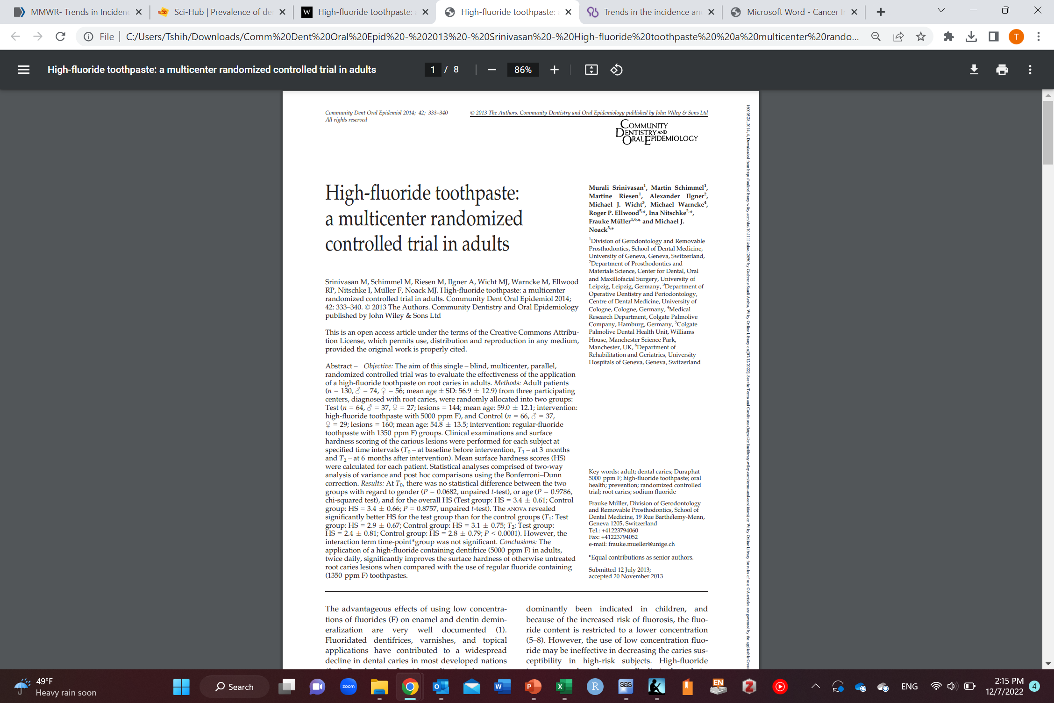
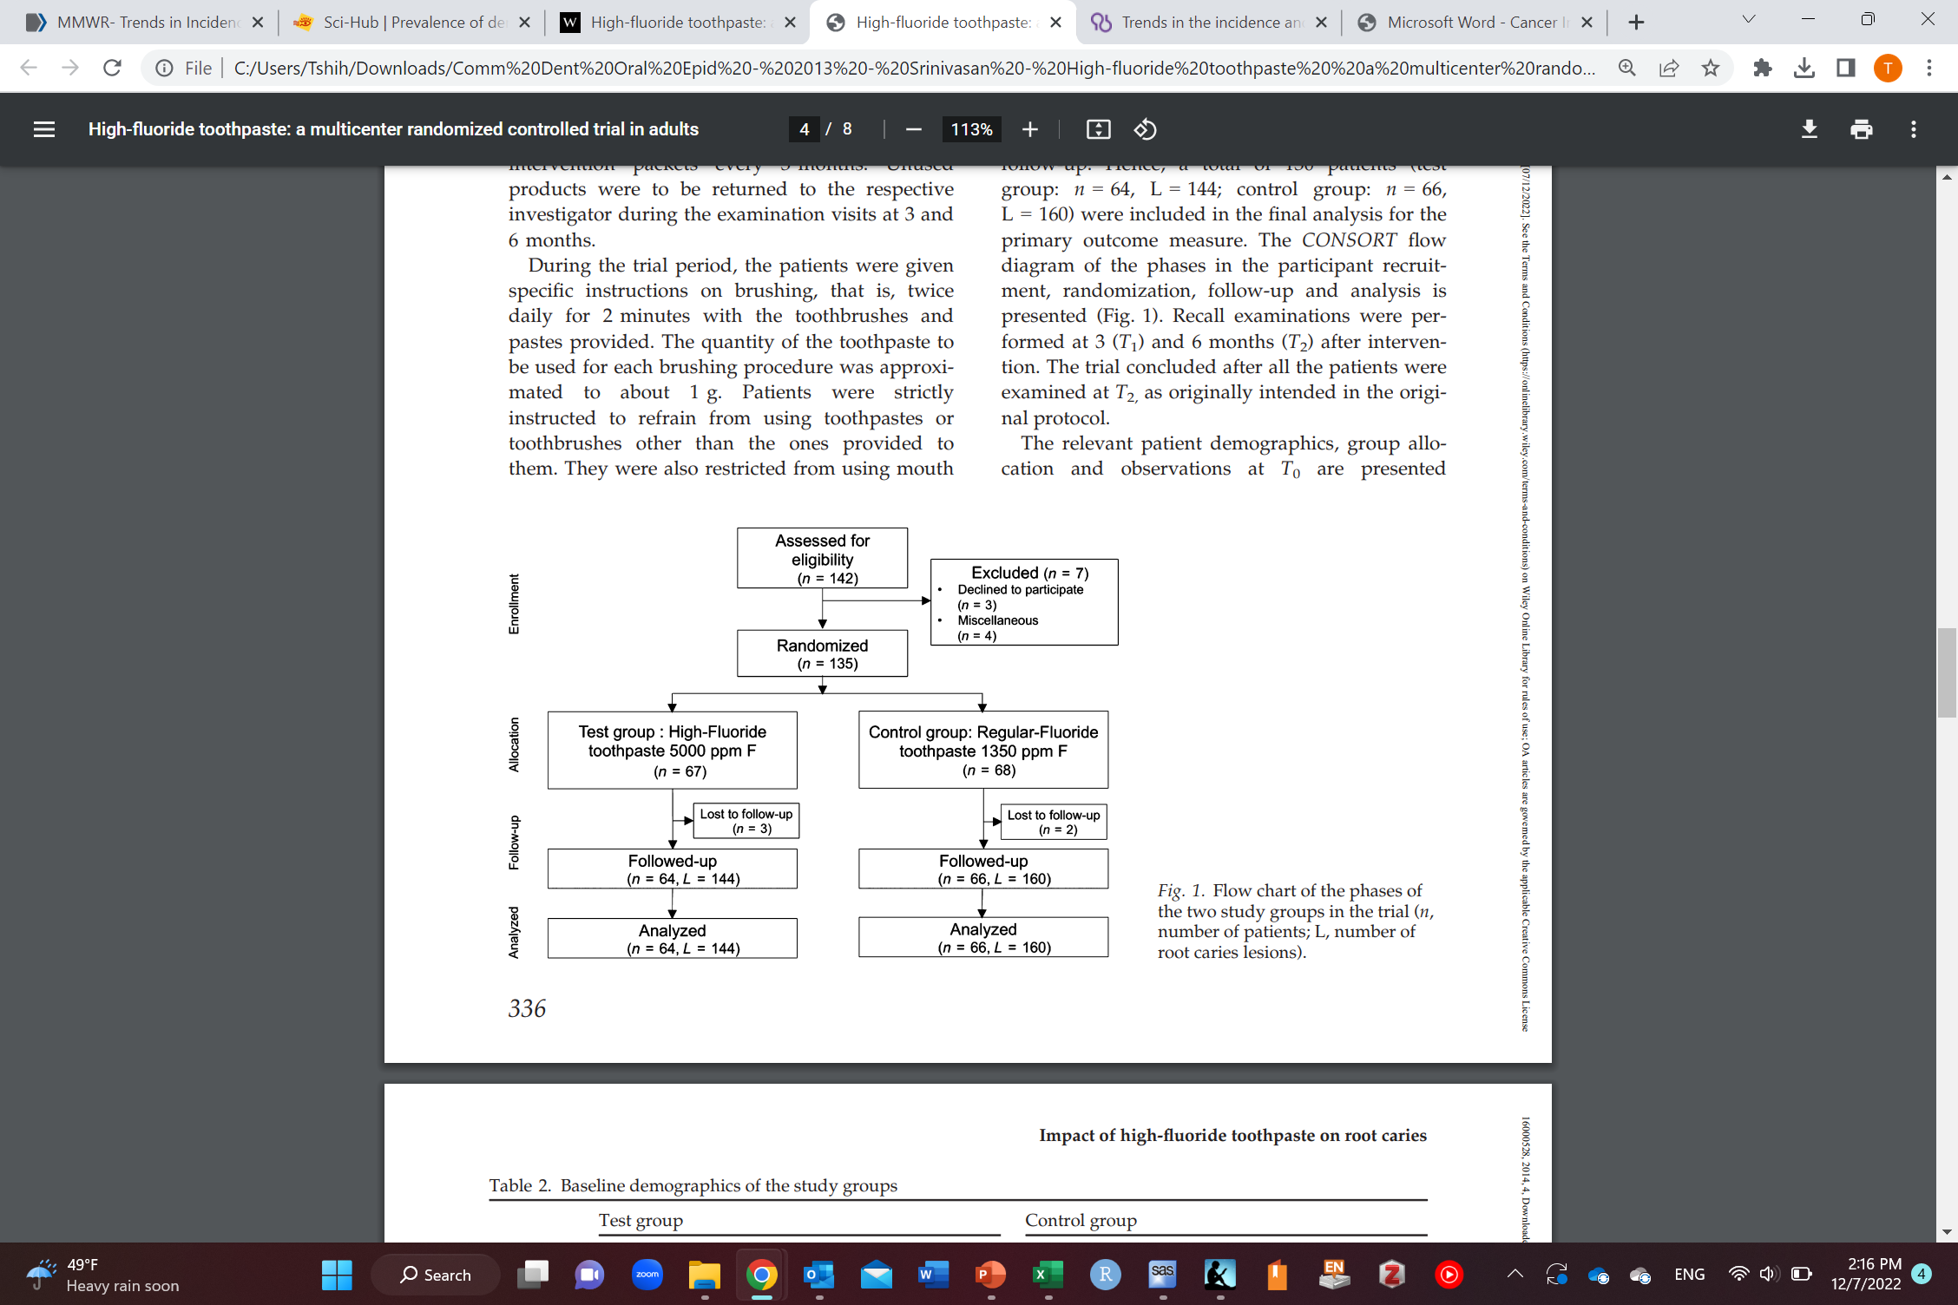
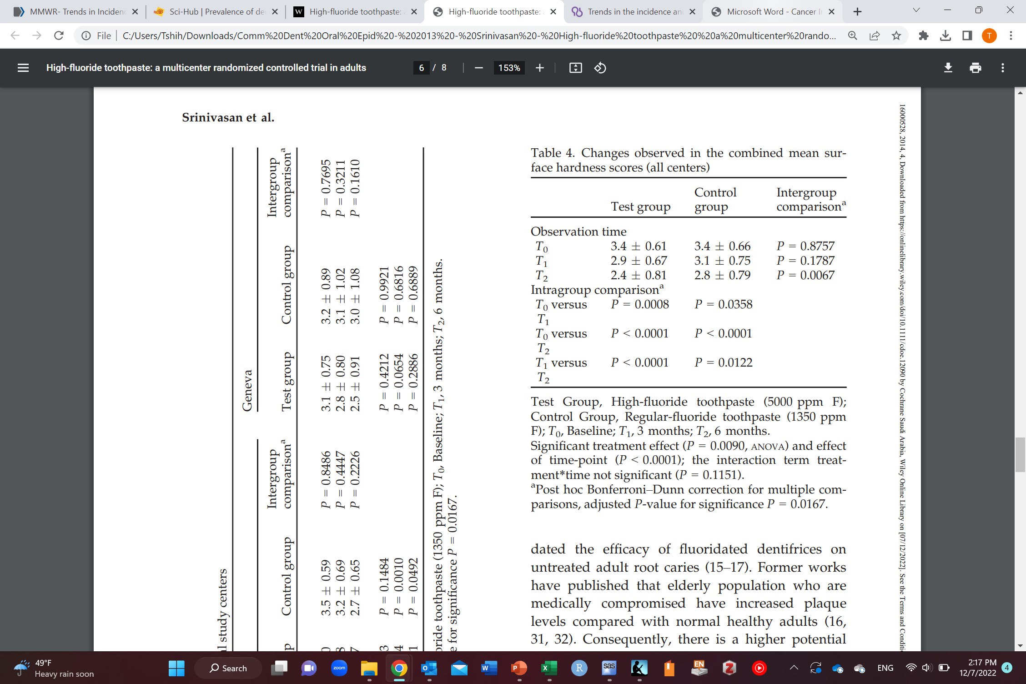
Example of RCT

Slide 39
Causal cohort study
Independent variable
Exposure
Only
Dependent variable
Outcome
Time 0
Baseline
Time

Slide 40
Causal cohort study
Time
 | With lung cancer | Without lung cancer | Total
Smokers | A | B | A+B
Non-smokers | C | D | C+D
Total | A+C | B+D | A+B+C+D
Incidence (risk) of lung cancer among smokers=$\frac{A}{A+B}$
Incidence (risk) of lung cancer among non-smokers=$\frac{C}{C+D}$
Incidence (risk) difference= $\text{incidence}\text{ (}\text{risk}\text{) }\text{of} \text{lung} \text{cancer} \text{among} \text{smokers} −\text{incidence}\text{ (}\text{risk}\text{) }\text{of} \text{lung} \text{cancer} \text{among} \text{non}\text{−}\text{smokers}$= $\frac{A}{A+B}$ - $\frac{C}{C+D}$
Incidence (risk) ratio=$\frac{\text{incidence} \text{(}\text{risk}\text{) }\text{of} \text{lung} \text{cancer} \text{among} \text{smokers}}{\text{incidence}\text{ (}\text{risk}\text{) }\text{of} \text{lung} \text{cancer} \text{among} \text{non}\text{−}\text{smokers}}$= $\frac{\frac{A}{A+B}}{\frac{C}{C+D}}$

Slide 41
Causal cohort study
Prospective vs retrospective cohort
If exposure is measured before the outcome (prospective)
If outcomes occurred already before exposure measurement (retrospective)
Secondary data (data that already exist such as in electronic medical records)
Prospective is better
Exposure measurement error does not differ between cases and controls
Retrospective
Since outcomes are already known at time of exposure measurement, exposure may be measured differently between cases and controls
Either from researchers or participants
Differential measurement error of exposure
Temporality may not be as established as a prospective cohort

Slide 42
Causal cohort study
Advantages
Has temporality (exposure occurs before outcome)
Can study multiple outcomes
Can study rare exposures (environmental exposures)
Disadvantages
Need large sample size (loss to follow-up)
Expensive to conduct (inefficient)
Time-consuming (inefficient)
Not suitable for rare outcomes (needs a very long time to have enough people that develop outcome)
Prone to confounding (mixing of effects)
Prone to selection bias
Baseline
Loss to follow-up
Prone to measurements error
Non-differential/random: prospective
Potentially differential: retrospective

Slide 43
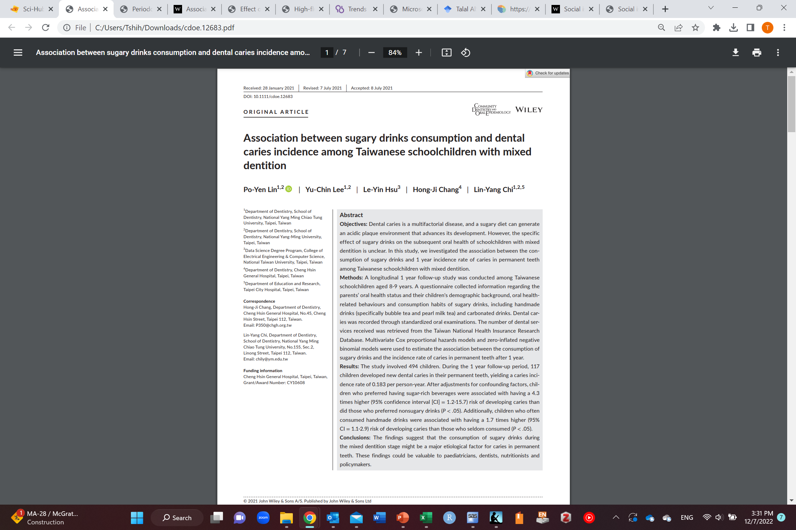
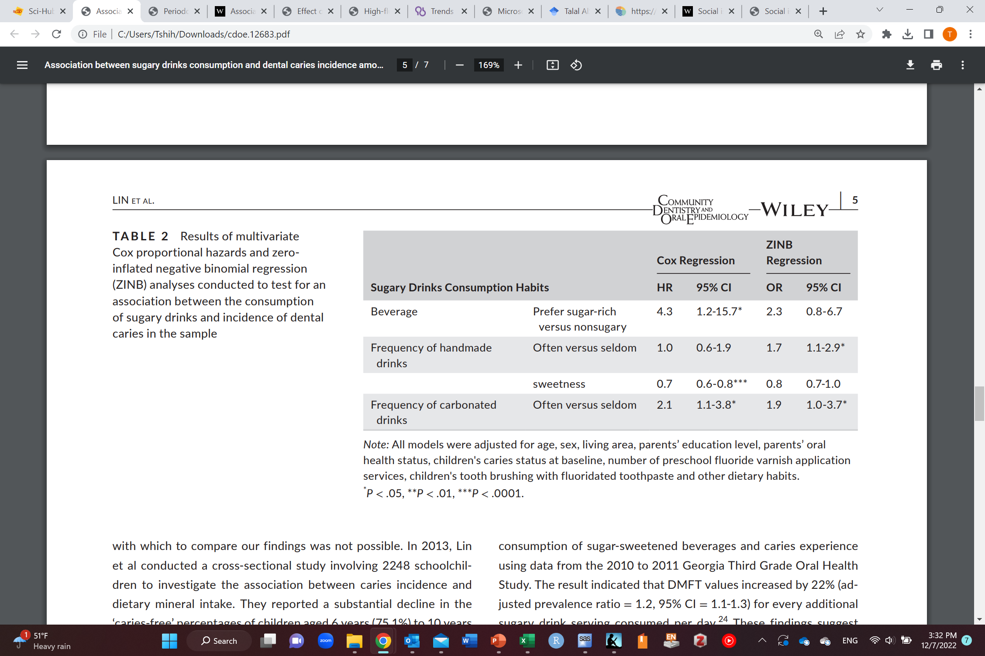
Example of a causal cohort

Slide 44
Case-control
Independent variable
Exposure
Dependent variable
Outcome
Time 0
Baseline
Time

Slide 45
Case-control
Include cases and then sample from the control
Control should reflect the population from which cases arise (not necessarily free of disease)
A more efficient design than a cohort study especially for a rare disease
Still a longitudinal design but temporality may not be as established as a prospective cohort

Slide 46
Case-control
Time 0
Baseline
Time
 | With lung cancer | Without lung cancer
Smokers | A | B
Non-smokers | C | D
Total | A+C | B+D
Incidence odds of lung cancer among exposed=$\frac{A}{1−A}=\frac{A}{B}$
Approximates incidence (risk) ratio if incidence < 0.1
Incidence odds of lung cancer among unexposed=$\frac{C}{1−C}=\frac{C}{D}$
Incidence odds ratio=$\frac{\text{incidence} \text{odds} \text{of} \text{lung} \text{cancer} \text{among} \text{exposed}}{\text{incidence} \text{odds} \text{of} \text{lung} \text{cancer} \text{among} \text{unexposed}}$= $\frac{\frac{A}{B}}{\frac{C}{D}}=\frac{A∗D}{B∗C}$
Difficult to interpret so only makes sense to interpret it as an approximation to incidence (risk) ratio

Slide 47
Case-control
Advantages
Can study multiple exposures
Can study rare outcomes
Smaller sample size compared to cohort (efficient)
Short duration (efficient)
Disadvantages
Temporality may not be as established as a prospective cohort
Not suitable for common outcomes (Odds ratio overestimate risk ratio)
Since the outcome is known already, the exposure may be measured differently between cases and controls
Cases are more/less likely to remember exposure
Differential measurement error of exposure (recall bias)
Prone to confounding (mixing of effects)
Prone to selection bias
If controls are not sample from the same population cases might arise from

Slide 48
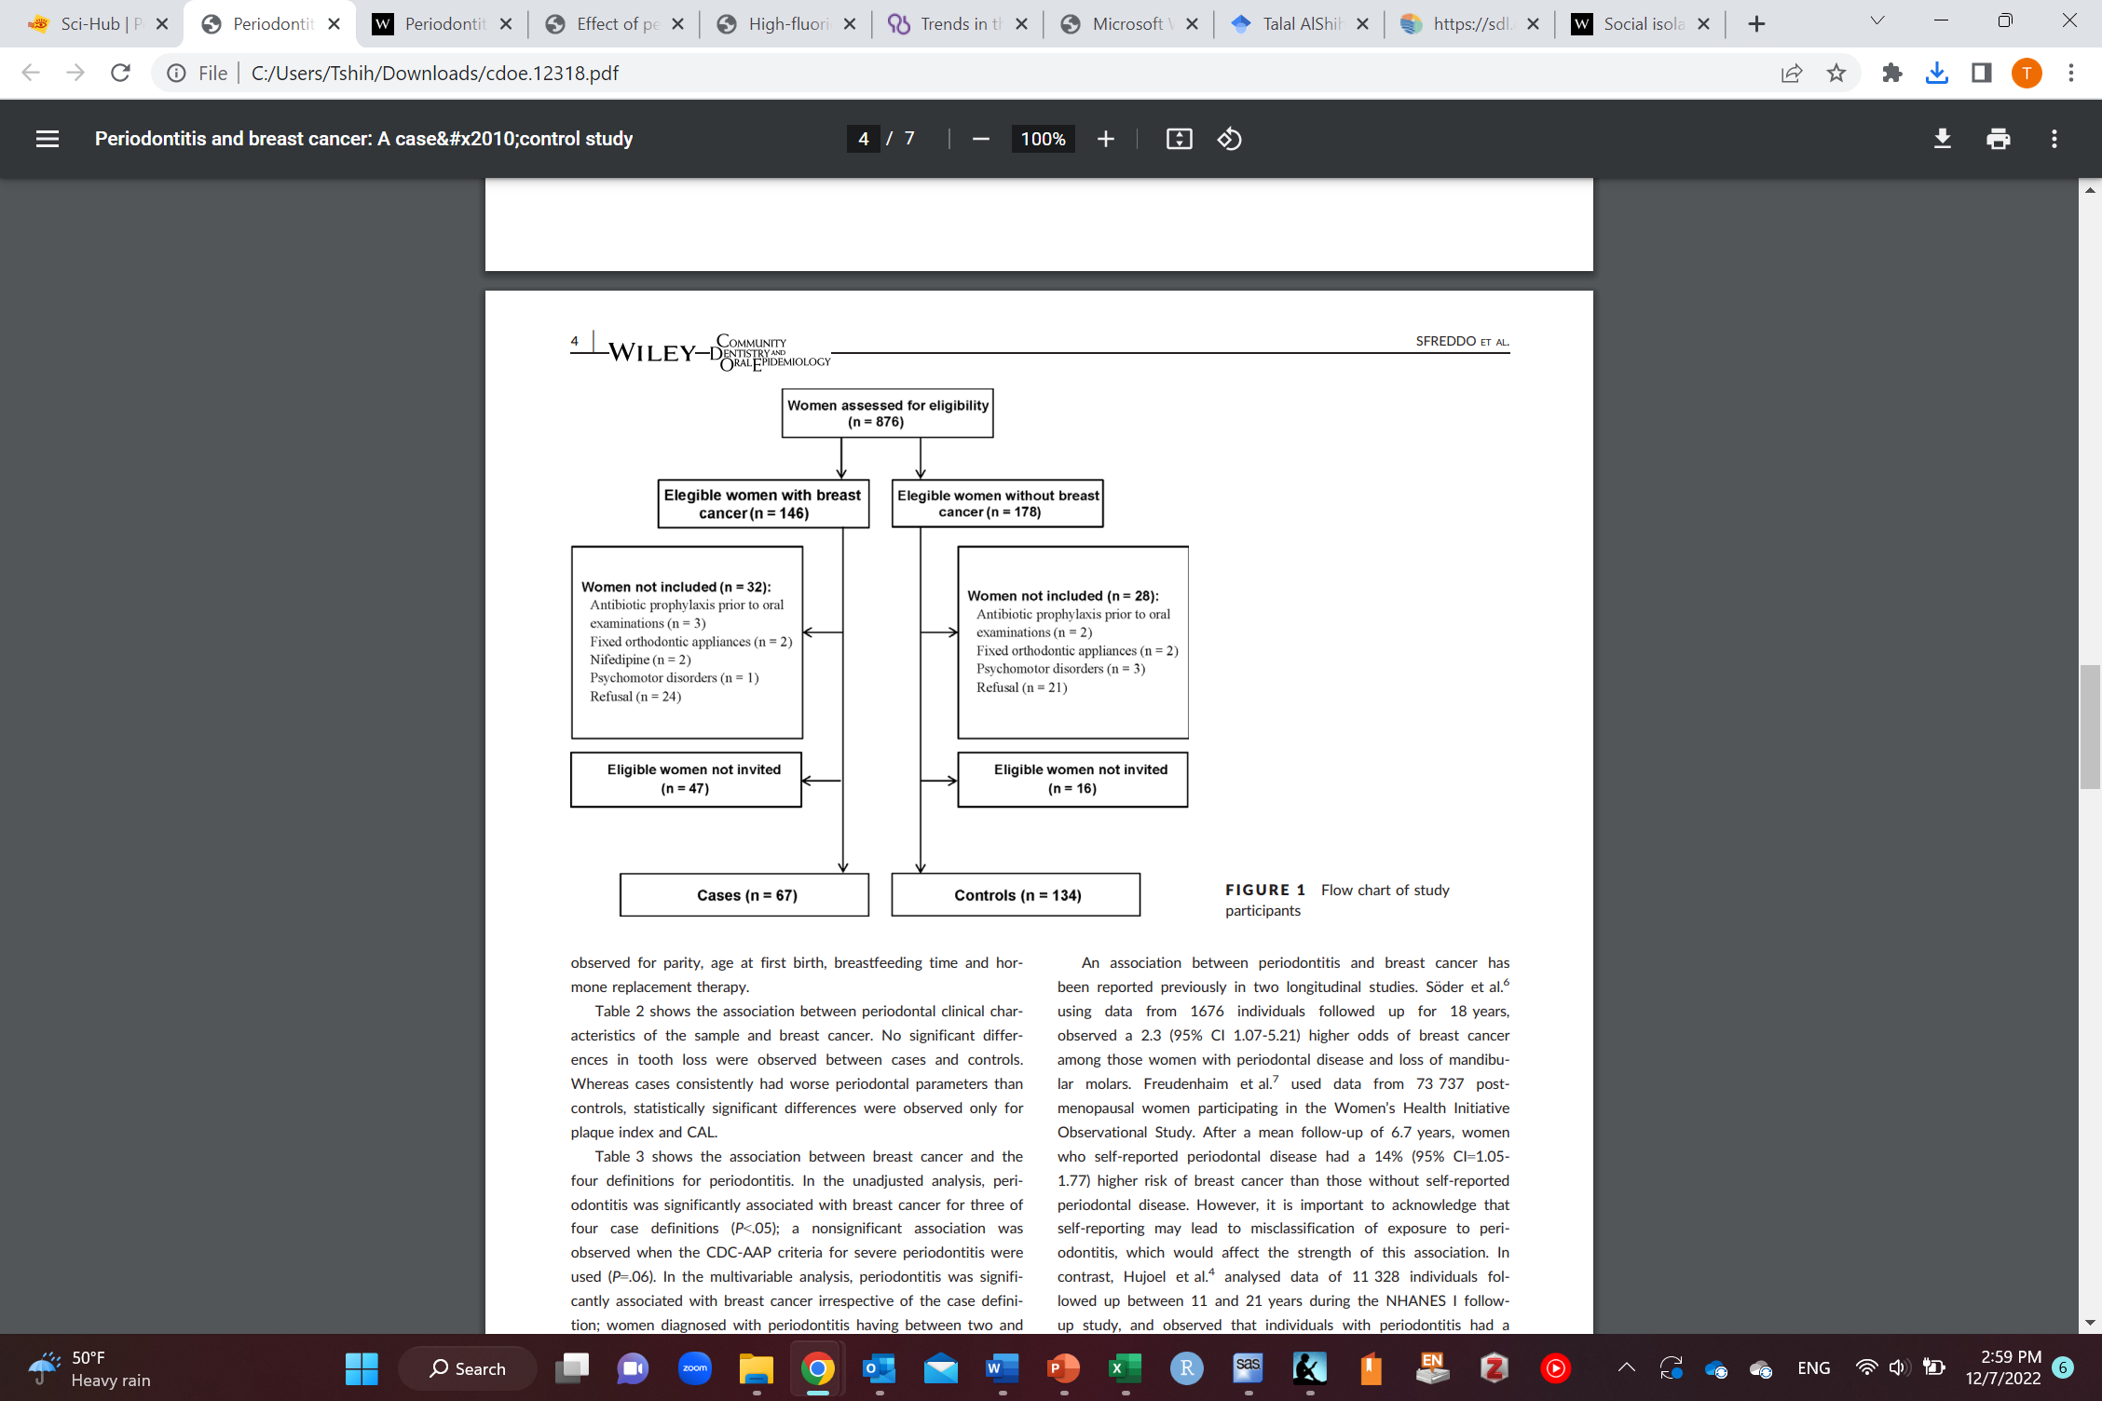
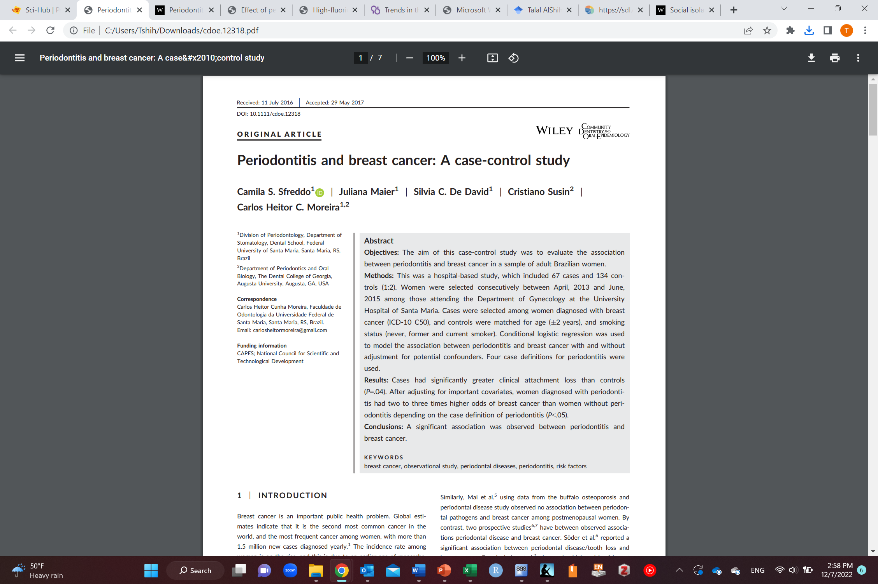
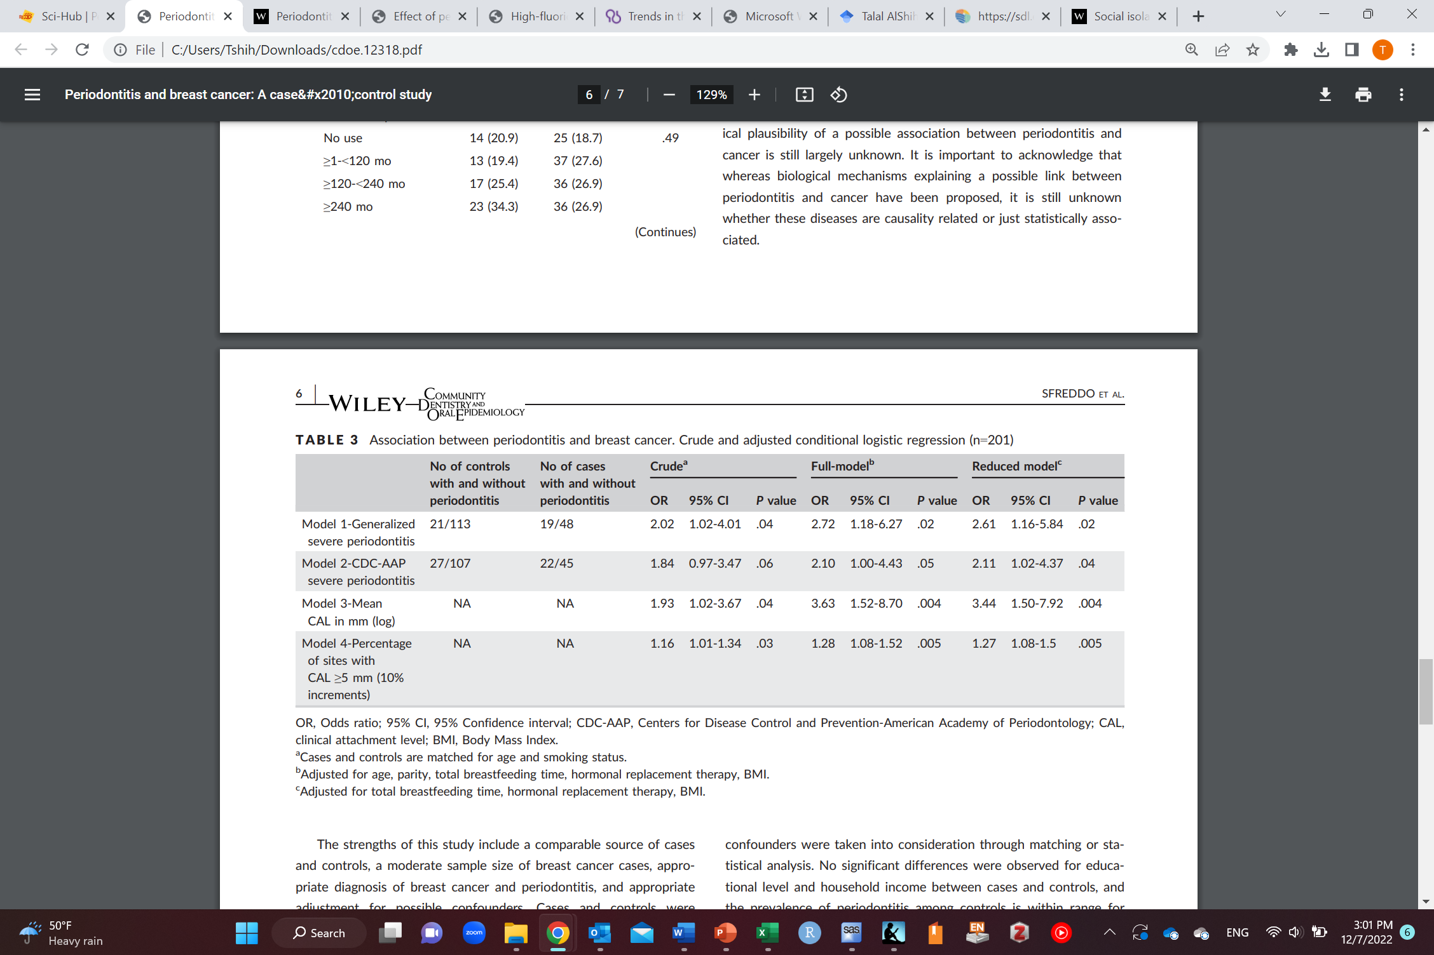
Example of a case-control

Slide 49
Causal cross-sectional study
Independent variable
Exposure
Dependent variable
Outcome
Time

Slide 50

Causal cross-sectional study
Time
 | With lung cancer | Without lung cancer | Total
Smokers | A | B | A+B
Non-smokers | C | D | C+D
Total | A+C | B+D | A+B+C+D
Prevalence of lung cancer among smokers=$\frac{A}{A+B}$
Prevalence of lung cancer among non-smokers=$\frac{C}{C+D}$
Prevalence ratio=$\frac{\text{prevalence} \text{of} \text{lung} \text{cancer} \text{among} \text{smokers}}{\text{prevalence} \text{of} \text{lung} \text{cancer} \text{among} \text{non}\text{−}\text{smokers}}$= $\frac{\frac{A}{A+B}}{\frac{C}{C+D}}$

Slide 51
Causal cross-sectional study
Time
 | With lung cancer | Without lung cancer
Smokers | A | B
Non-smokers | C | D
Total | A+C | B+D
Prevalence odds of lung cancer among exposed=$\frac{A}{1−A}=\frac{A}{B}$
Approximates prevalence ratio if prevalence < 0.1
Prevalence odds of lung cancer among unexposed=$\frac{C}{1−C}=\frac{C}{D}$
Prevalence odds ratio=$\frac{\text{prevalence} \text{odds} \text{of} \text{lung} \text{cancer} \text{among} \text{exposed}}{\text{prevalence} \text{odds} \text{of} \text{lung} \text{cancer} \text{among} \text{unexposed}}$= $\frac{\frac{A}{B}}{\frac{C}{D}}=\frac{A∗D}{B∗C}$
Difficult to interpret so only makes sense to interpret it as an approximation to prevalence ratio

Slide 52

Causal cross-sectional study
Advantages
Convenient
One point of time (short)
Inexpensive
Good for disease surveillance
Disadvantages
A snapshot of exposure and outcome (which came first?)
No temporality (exposure precedes the outcome)
Cannot establish causality
Prone to confounding (mixing of effects)
Prone to selection bias (if sample not representative)
Prone to measurements error
Notes:
Might be done first to study effects and then later confirmed in other study designs

Slide 53
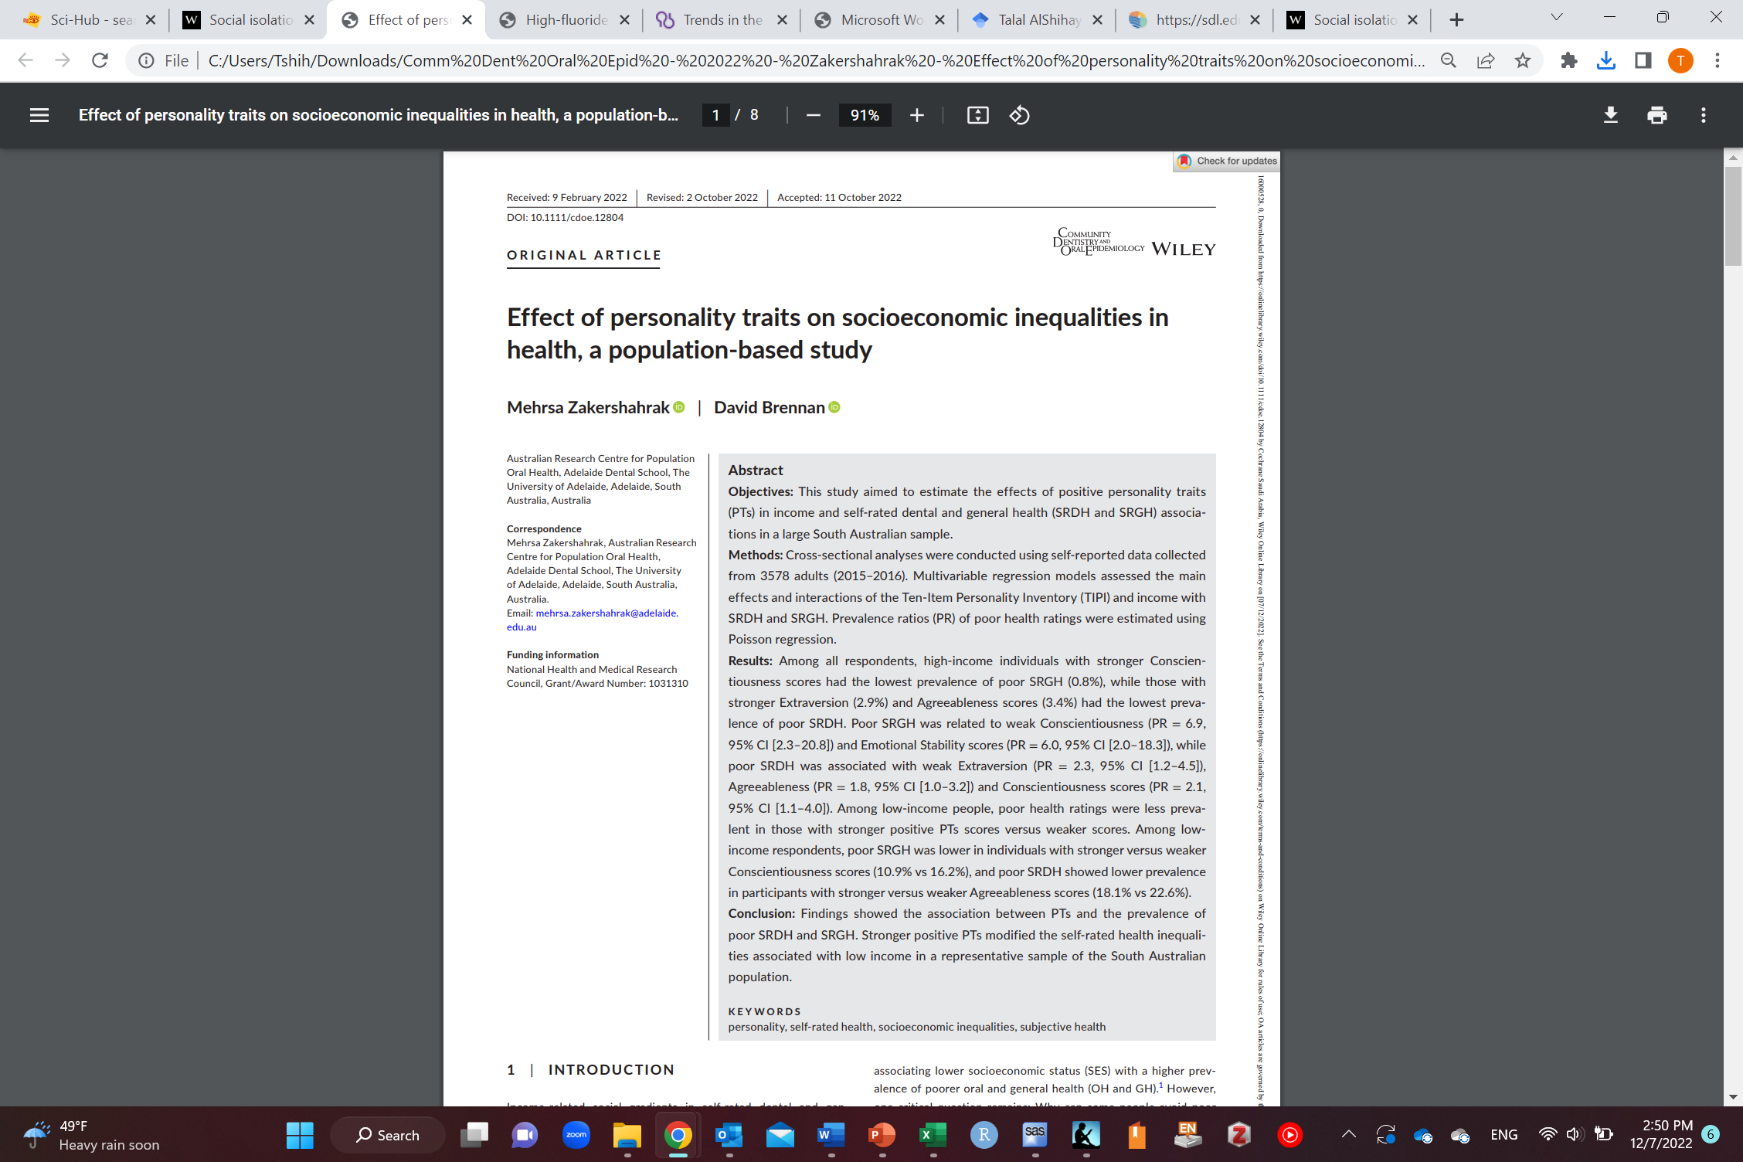
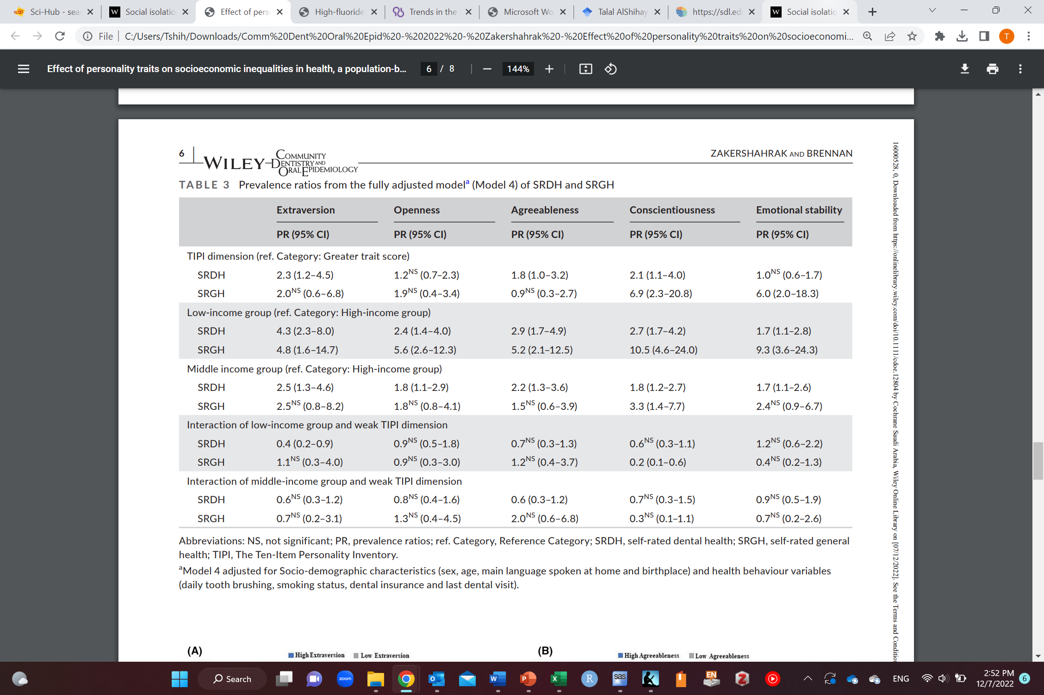
Example of a causal cross-sectional study

Slide 54
Any Questions?
shihaybt@ksau-hs.edu.sa

